Slide 1
HS Climate Resiliency Unit
Lesson 1

Slide 2
Do now
Think back to a really hot day last summer, what was it like? Describe it. What did you do during that day?

Slide 3
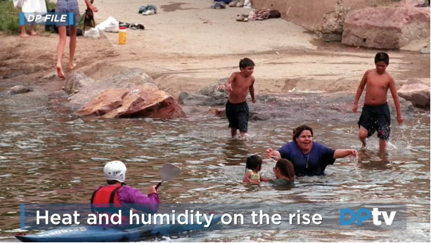
Notes:
http://www.denverpost.com/2016/07/14/colorado-summers-getting-hotter-stickier/
STOP VIDEO AT: -:28 SECONDS BEFORE “THIS STUDY SHOWS…”
3. (20-30 min) Show the Denver news story about rising temperatures in Colorado. Stop the video at -:28. Consider showing it twice if you think students would benefit from that. When the video is complete have a Generating and Prioritizing Questions Discussion ^{B}.
Suggested Prompts:
What questions do you have about the video and what's going on in Colorado with increasing summer temperatures?
Why do you think this is happening? What hypotheses do you have for why this is happening?

Slide 4
Generating Questions
What questions do you have about the increase in Colorado’s cities temperatures?
Notes:
Suggested Prompts:
What questions do you have about the video and what's going on in Colorado with increasing summer temperatures?
Why do you think this is happening? What hypotheses do you have for why this is happening?
Listen for student responses and write all student question on a Driving Questions Board ^{C} that you will display^{D}, update, and check off throughout the unit. Listen for student questions, such as:
Why these cities?
Where are the cities that are getting hotter?
Is it because these cities are getting bigger? Is it because these cities have universities?
Are they just in Colorado?
What’s special about the cities where it’s getting hotter compared to the ones where it’s not?
What about rural areas? It is getting hotter everywhere or is it just happening in the cities?
What about places at altitude?
What is Texas like? How hot is South Texas?
What’s humidity? What’s that like?
Is this really a trend?
Was it always this hot?
Could it get colder? What’s happening in the winter?
Is this unusual or a trend? For how long?
If it’s a trend, is the trend just here in CO, or elsewhere?
What does “global warming have to do with it?
Is it getting drier, too?
Are people dying?
Are plants dying?
What’s causing the trend?
We have some hypotheses about this we want to investigate:
Climate change is causing it. Is this real?
What do parking lots and other things that are in cities have to do with it?
Do cars have anything to do with it?
What about greenhouse gases?
What might pollution have to do with it? What about factories that we see in the media?
People make trash and waste.
If there’s more people, is there more pollution, and does that matter for the trend?
What’s happens when it gets so hot?
Why is this bad? Is climate change bad?
How does heat affect people and animals? Should I be concerned?
Once you’ve generated a list of questions, group the questions. Four groups that might emerge are: Why these cities?, It is really a trend?, What’s causing the trend?, and What happens when it gets so hot? Then ask students to nominate which group of questions you need to answer first to figure out why the temperatures are changing in Colorado.

Slide 5
Grouping and Prioritizing Questions
Are there common themes among our questions?
Could we group these questions into categories?
Notes:
Once you’ve generated a list of questions, group the questions. Four groups that might emerge are: Why these cities?, It is really a trend?, What’s causing the trend?, and What happens when it gets so hot? Then ask students to nominate which group of questions you need to answer first to figure out why the temperatures are changing in Colorado.

Slide 6
Where should we go next?
How could we answer our questions?
What question or group of questions should we start with?
Notes:
Anticipate that students might say something else but listen for votes for the cities focus. Lesson 2 focuses on cities and the data in the report - guide students to choose looking at cities and the report.
Listen for student responses, such as:
We decided we wanted to start by trying to understand what is going on with these cities, and if there’s something special about these cities that makes them different.
We should figure out what is special about these cities.
We should look at the report that the video is talking about.
4. (2-5 min) Wrap up by highlighting the questions on the Driving Questions Board you will group together and answer first.
If you have time remaining in the lesson, have students come up with ways the groups of questions could be answered^{E}.
Suggested Prompts:
How could we answer these questions?
What could we do in class to answer our questions?
What resources could we use?
Listen for student responses, such as:
We could look at the report they mentioned in the video.
We could look at other sources of climate data.
I heard NASA had data on global temperatures; maybe we could look at that.
We could read about case studies of ways increased global temperatures are already impacting cities worldwide.
We should look at historical climate data from long time ago.
We have heard about the greenhouse effect but don’t really know how it works so maybe we could watch a video on it.
We could do a simulation on the greenhouse effect.

