Slide 1
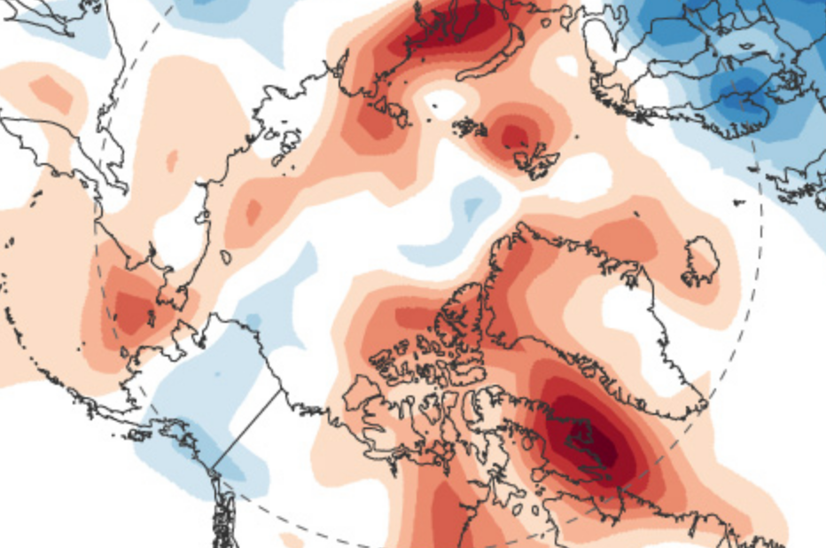
Are other parts of the world getting hotter?
Lesson 4
Notes:
Image source: https://www.climate.gov/news-features/event-tracker/february-2018-heatwave-across-far-north

Slide 2
Do Now
During our last class, we looked at how the different surfaces in a place can make that place warmer or cooler.
Answer these questions on your student activity sheet:
What did we learn about the colors of surfaces and temperatures?
What does this tell us about the amount of light reflected and temperature?
What did we decide to figure out next?
Notes:
(10 min) Begin with a Consensus Building Discussion ¹ to help reorient students in the story line. Use the following prompts to help students articulate what they figured out in the last lesson.
Suggested Prompts:
During our last two classes, we looked at how the surfaces in a place can make it warmer or cooler.
What did we find out about the colors of surfaces and temperatures?
What does this tell us about the amount of light reflected and temperature?
What does this tell us about why growing cities are hotter?
What did we decide that we should look at next?
Listen for student responses ² that refer to what we figured out last time, such as:
We learned that darker surfaces are warmer than lighter-colored surfaces.
This shows us that as cities grow in population, more plant surfaces are replaced with dark surfaces, and so the cities get hotter.
We did an experiment that showed how light reflected on different colored surfaces raised the temperature to different levels.
We decided to look if other parts of the world are getting hotter, too.

Slide 3
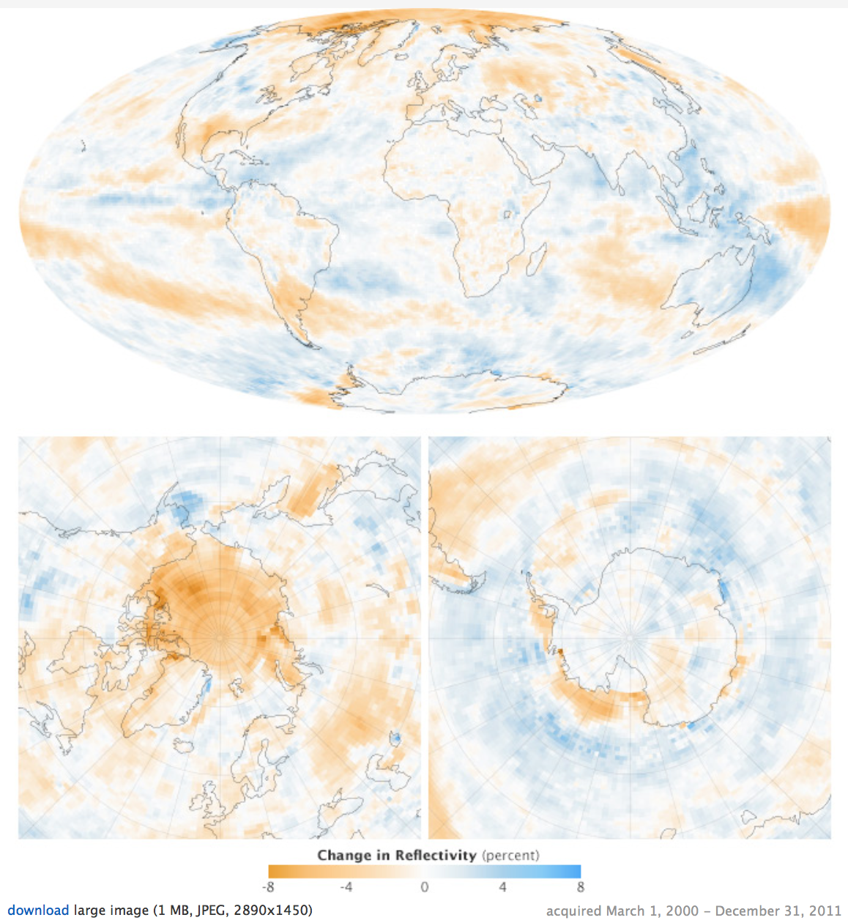
How has surface reflection changed around the world?
Notes:
2. (10 min) Albedo around the world
Have students look at the map that shows changes in albedo (reflectivity) around the world. Students look for patterns in the temperature changes. Have students work in groups of 3-4 to describe the relationship they observe between albedo and temperature changes they see.
Building Understandings Discussion: Review the title and map key as a class. Invite a group to share their explanation of patterns found in the data. Invite other students to respond (agree/disagree/add) to the explanation.
Listen for understanding and confusion around the patterns:
The blue means more reflective surface and so temperatures should not be as warm.
The red means less reflective surface so temperatures should be warmer.
Why is the Arctic less reflective and Antarctica more reflective surface since they’re both polar regions?
Northern and central US is more reflective while the southern US has a less reflective surface cover.

Slide 4
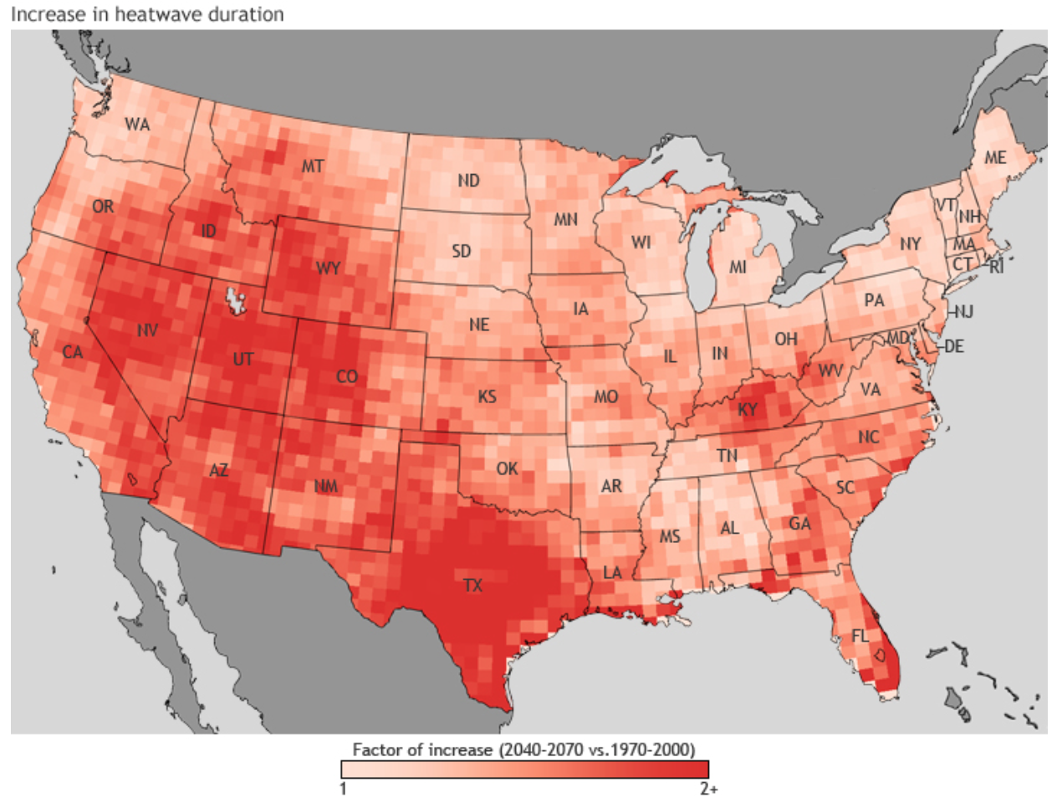
Are other parts of the US getting hotter?
Notes:
3. (10 min) Temperature in other parts of the US
Give students the map that shows the changes in heat wave duration around the continental US. Students look for patterns in the temperature changes. Have students work in groups of 3-4 to formulate an explanation of the patterns they see.
Building Understandings Discussion: Review the title and map key as a class. Invite a group to share their explanation of patterns found in the data. Invite other students to respond (agree/disagree/add) to the explanation.
Listen for understanding and confusion around the patterns:
Areas without large populations/cities (e.g. western states) have longer heat waves than areas with large populations/cities (e.g. east and west coast states) This is a little confusing since there are more land use changes in populated areas than less populated areas.
We learned yesterday that as more people move to a city plant surfaces are replaced by dark surfaces, which increases temperatures.

Slide 5
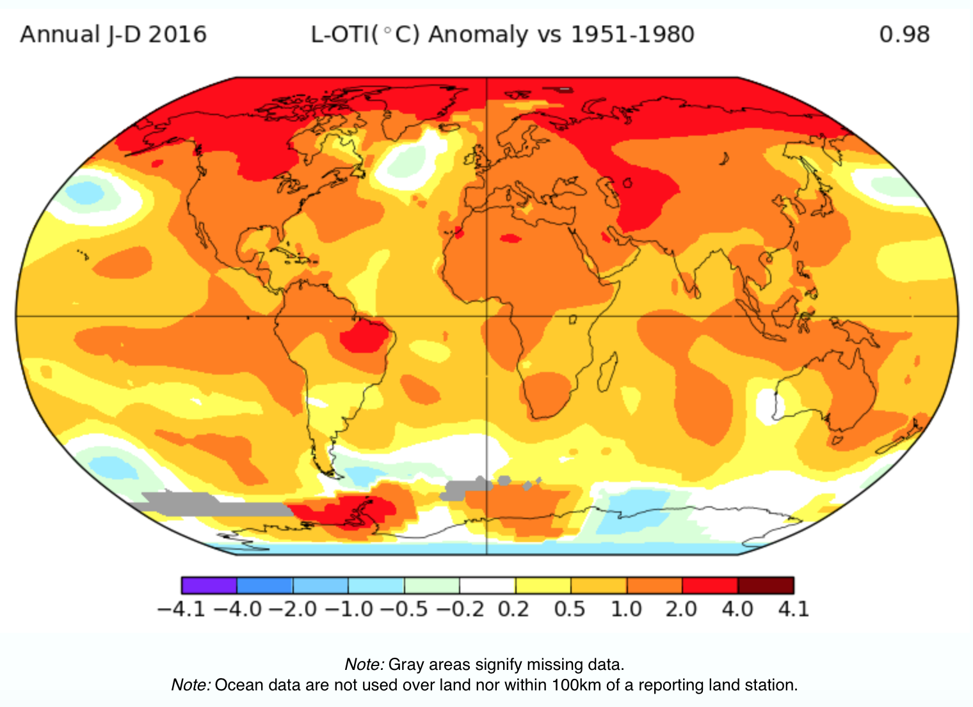
How are temperatures around the world changing?
Notes:
4. (20 min) Temperature in other parts of the world
Have students look at the map that shows the changes in the global mean surface temperatures and average global temperatures. Students look for patterns in the temperature changes. Have students work in groups of 3-4 to formulate an explanation of the patterns they see.
Building Understandings Discussion: Review the title and map key as a class. Invite a group to share their explanation of patterns found in the data. Invite other students to respond (agree/disagree/add) to the explanation.
Have students look at the graph of the land-ocean temperature index (next slide). Review the title and axis labels as a class. Students should work in groups of 3-4 to formulate an explanation of the patterns they see.
Listen for understanding and confusion around the patterns:
The Arctic is warming most above normal but there isn’t a lot of land use changes or people living there. Since the world as a whole has been getting warmer, the snow in the Arctic has been melting, which exposes darker dirt and rock underneath, which absorbs more light and heat than snow.
Why is Antarctica cooling?
Most of the world looks to be increasing in temperature.
Why isn’t the area around the equator the warmest?
Global temperatures have been rising above normal since the 1970s?
Global temperatures rising the fastest since 2010?
I wonder what global temperatures were like before 1880?
I wonder what global temperatures will be like in the future?

Slide 6
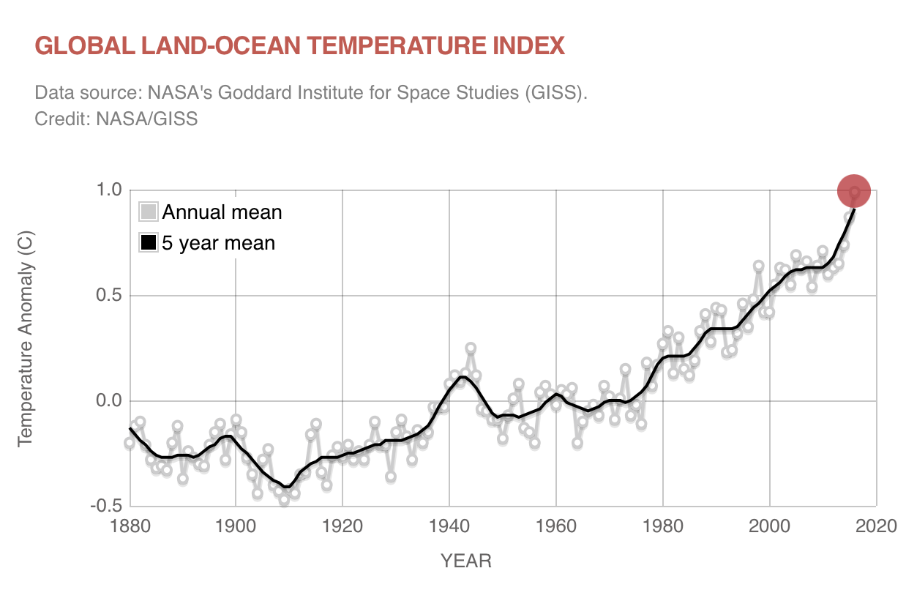
Are temperatures around the world changing over time?
Notes:
4. (20 min) Temperature in other parts around the world
Have students look at the map that shows the changes in the global mean surface temperatures and average global temperatures. Students look for patterns in the temperature changes. Have students work in groups of 3-4 to formulate an explanation of the patterns they see.
Building Understandings Discussion: Review the title and map key as a class. Invite a group to share their explanation of patterns found in the data. Invite other students to respond (agree/disagree/add) to the explanation.
Have students look at the graph of the land-ocean temperature index. Review the title and axis labels as a class. Students should work in groups of 3-4 to formulate an explanation of the patterns they see.
Listen for understanding and confusion around the patterns:
The Arctic is warming the most above normal but there isn’t a lot of land use changes or people living there. Since the world as a whole has been getting warmer, the snow in the Arctic has been melting, which exposes darker dirt and rock underneath, which absorbs more light and heat than snow.
Why is Antarctica cooling?
Most of the world looks to be increasing in temperature.
Why isn’t the area around the equator the warmest?
Global temperatures have been rising above normal since the 1970s?
Global temperatures rising the fastest since 2010?
I wonder what global temperatures were like before 1880?
I wonder what global temperatures will be like in the future?

Slide 7
What do we know so far?
Use words and pictures to model and describe what is happening to temperatures around the world.
What changes over time have we seen?
What evidence do we have for those changes?
How are those changes related to each other?
Notes:
5. (15 min) Draw and explain a model of what we know so far.
Invite students to draw a model to explain what we have figured out so far about temperatures in other parts of the world. In their models, students should include how the different changes we have seen affect each other, and include evidence we have seen for these changes. Encourage students to record questions that come up as they are drawing and writing.
Ask students:
Are temperatures in other areas of the world getting hotter, too? Do you think changes in population or surface coverage is causing this to happen, like in the cities, or do you think there may be other reasons? How do you know?
Listen for:
Temperatures in other parts of the world are getting warmer.
Some areas that are getting warmer are also areas that have more reflection, which doesn’t make sense (e.g. the area in the US with increased heat wave duration have more reflectivity)
Areas that are normally the coldest are warming the most (e.g. the Arctic is warming at a greater rate even though there is much less population or land use changes there and it’s usually more snow and ice covered so it’s more reflective and should not be not warm as much).

Slide 8
What have we learned?
What is happening to the temperature in other parts of the world?
Do you think growing cities (population increase and changes in land use) are the main cause of temperature changes around the world? Or is it some other cause?
What does this tell us?
Notes:
6. (10 min) What have we figured out? What should we do next?
Have students reflect on what we have learned about temperatures in other parts of the world.
Suggested Prompts:
What is happening with temperature and heat waves in the rest of Colorado and the lower 48 states?
What is happening with temperature in other parts of the world?
What does this tell us?
Listen for student responses such as:
It seems like other areas without growing cities or many land use changes are also experiencing increases in temperatures.
This shows us that temperature increases are happening on a world scale and something else besides increases in population and land use changes is causing this to happen.

Slide 9
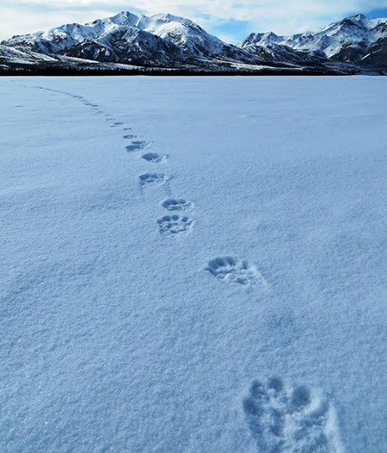
What’s our next step?
What do we need to figure out next about warming temperatures on Earth?
How can we figure this out?
Notes:
7. Ask students to brainstorm what we should do next in our investigation.
Suggested Prompts:
What do we need to figure out next?
How can we figure this out?
Listen for student responses such as:
We need to know if warming temperatures are a pattern.
We should look at data to find out what temperatures were like in the past.
Image: https://www.nps.gov/dena/learn/nature/wilderness.htm

