Slide 1
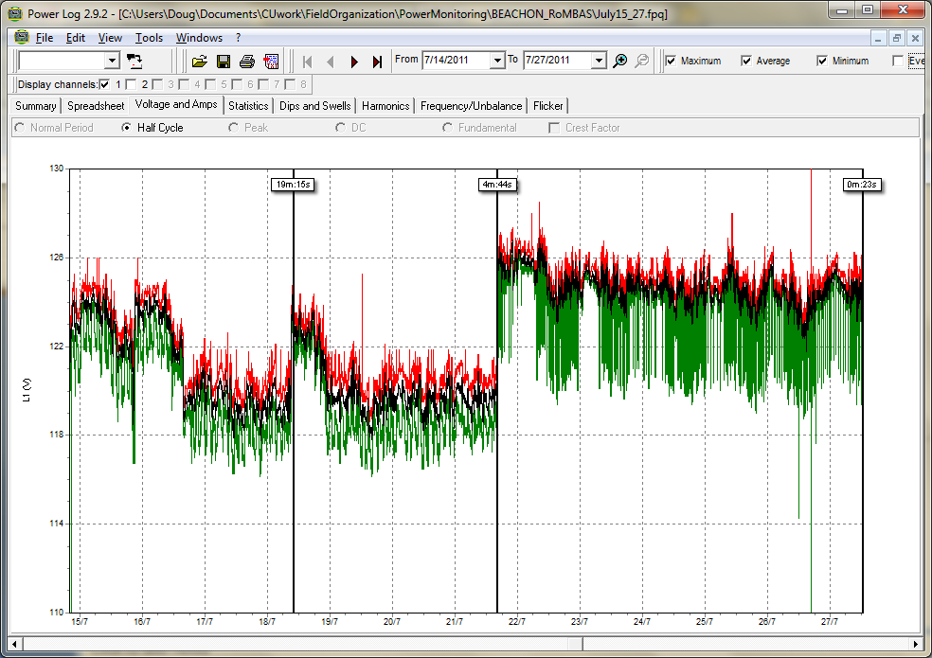
July 15-27 RoMBAS Voltage
7/21 switch from old (ST#2) to new power (phase A Rental Trailer #8)
New power has drops from ~125V to ~120 volts every ~15 minutes more frequently during day – probably our AC cycling.

Slide 2
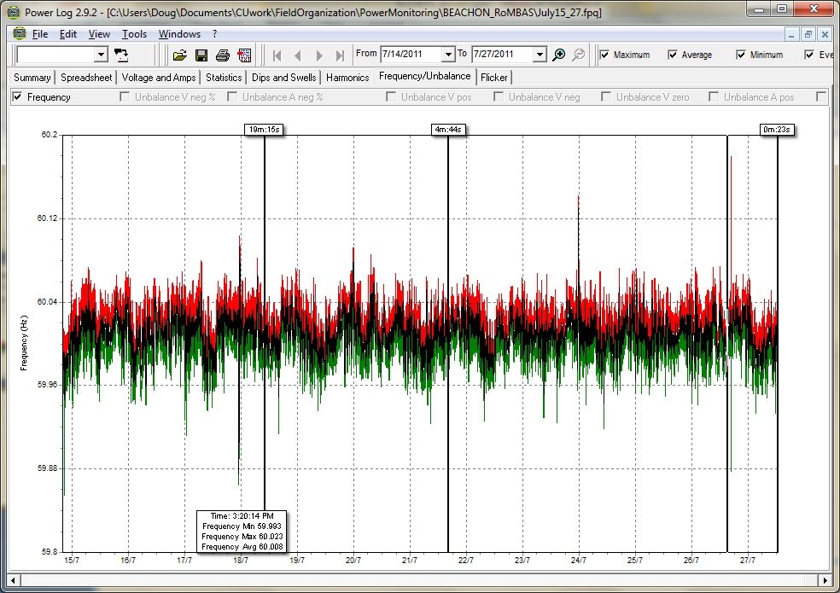
Frequency very stable.

Slide 3
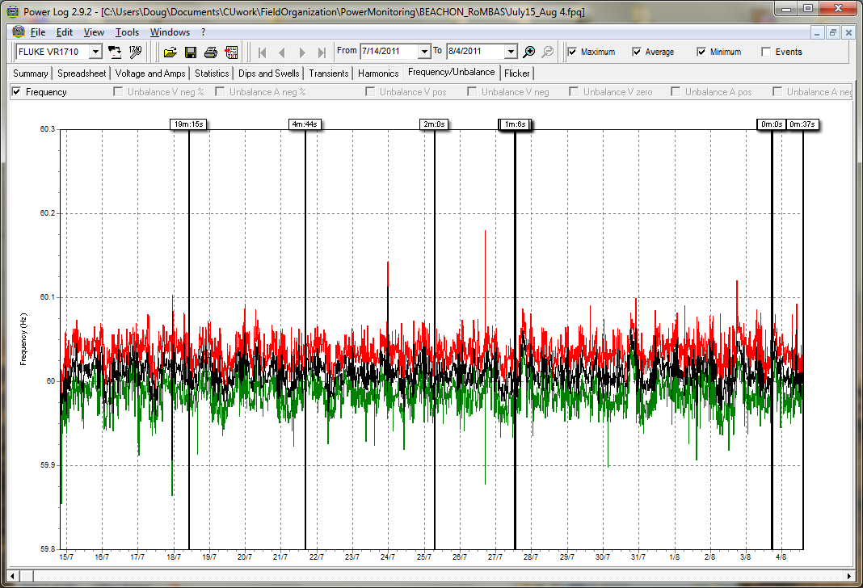
Power: Frequency

Slide 4
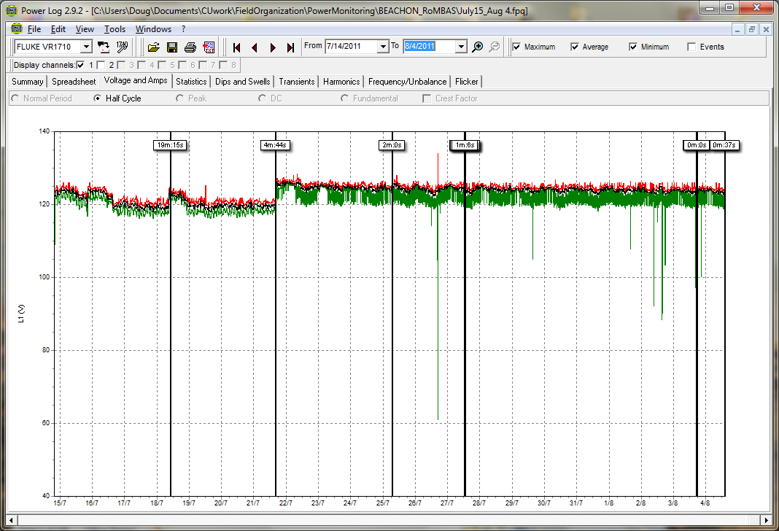
Power: Voltage/Dropouts Green are power dips (black are when monitor unplugged)

Slide 5
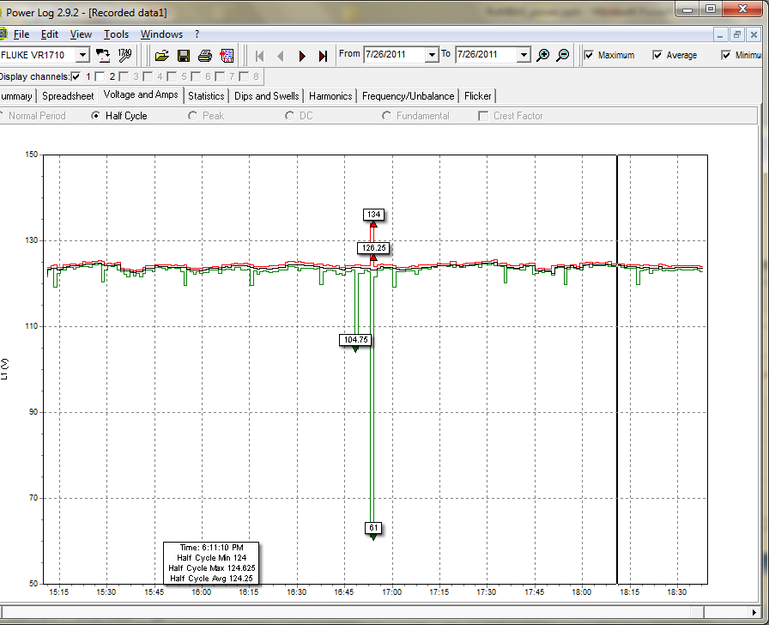
July 27 power drop-out Dropped to 105V a few minutes before the main spike which was 134/61V high/low

