Slide 1
Issues with Dancing Servos
Matt Coggon

Slide 4
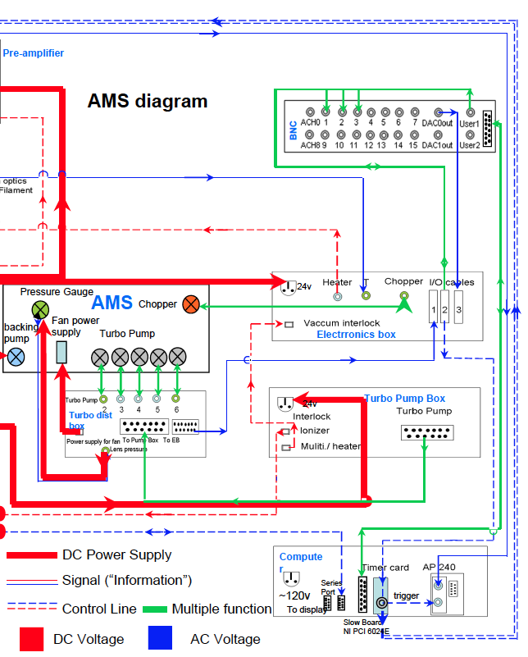

Slide 7
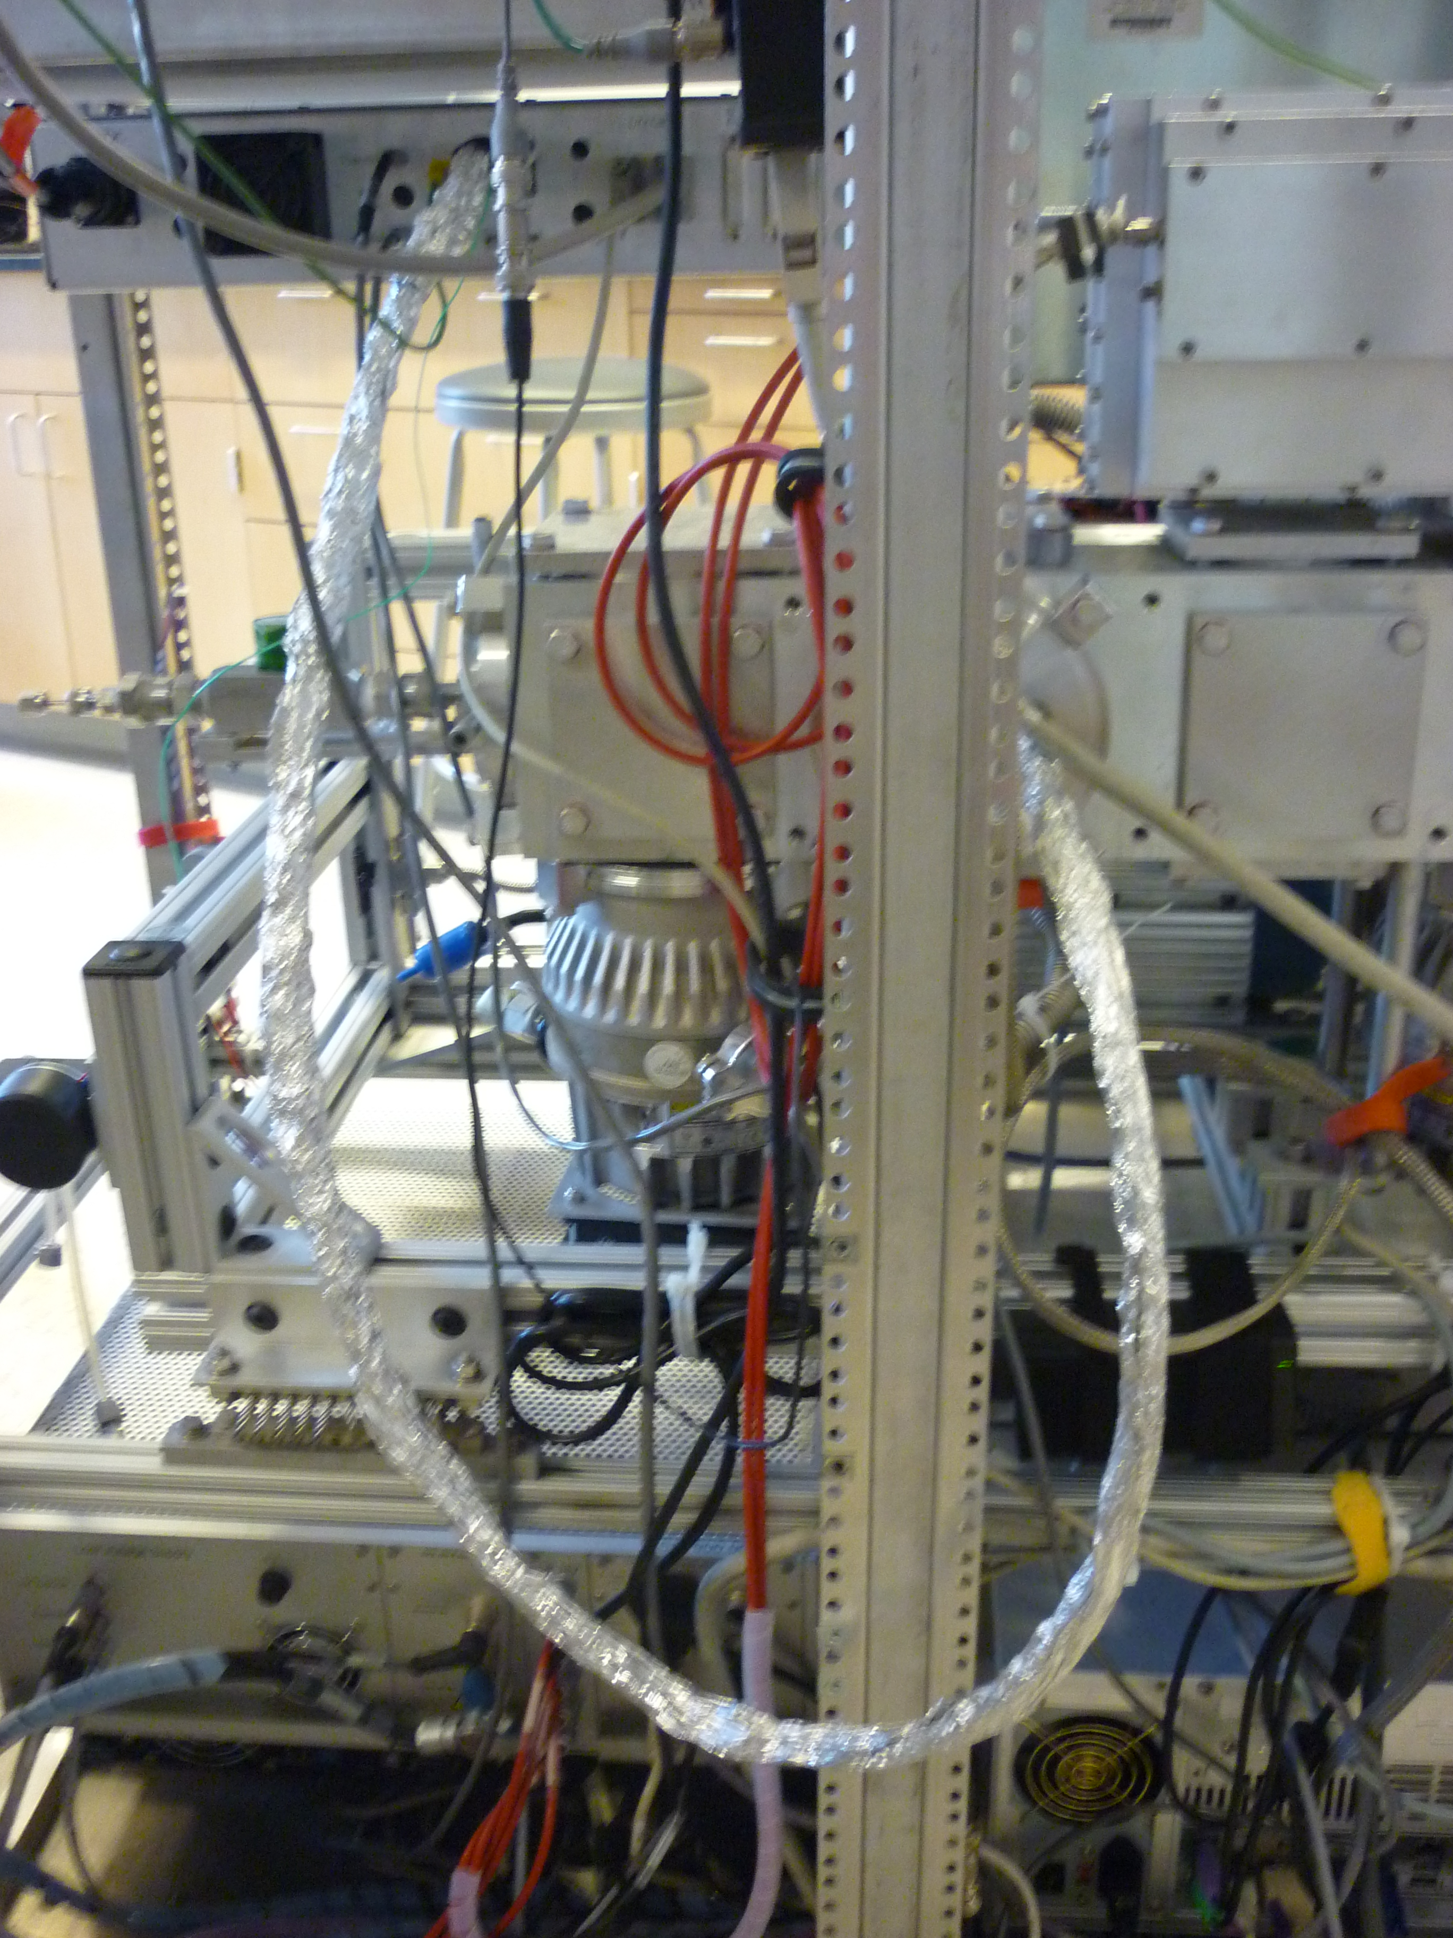
Quick Shielding :
1) Wrap in Aluminum Foil
2) Ground to AMS Frame

