Slide 1
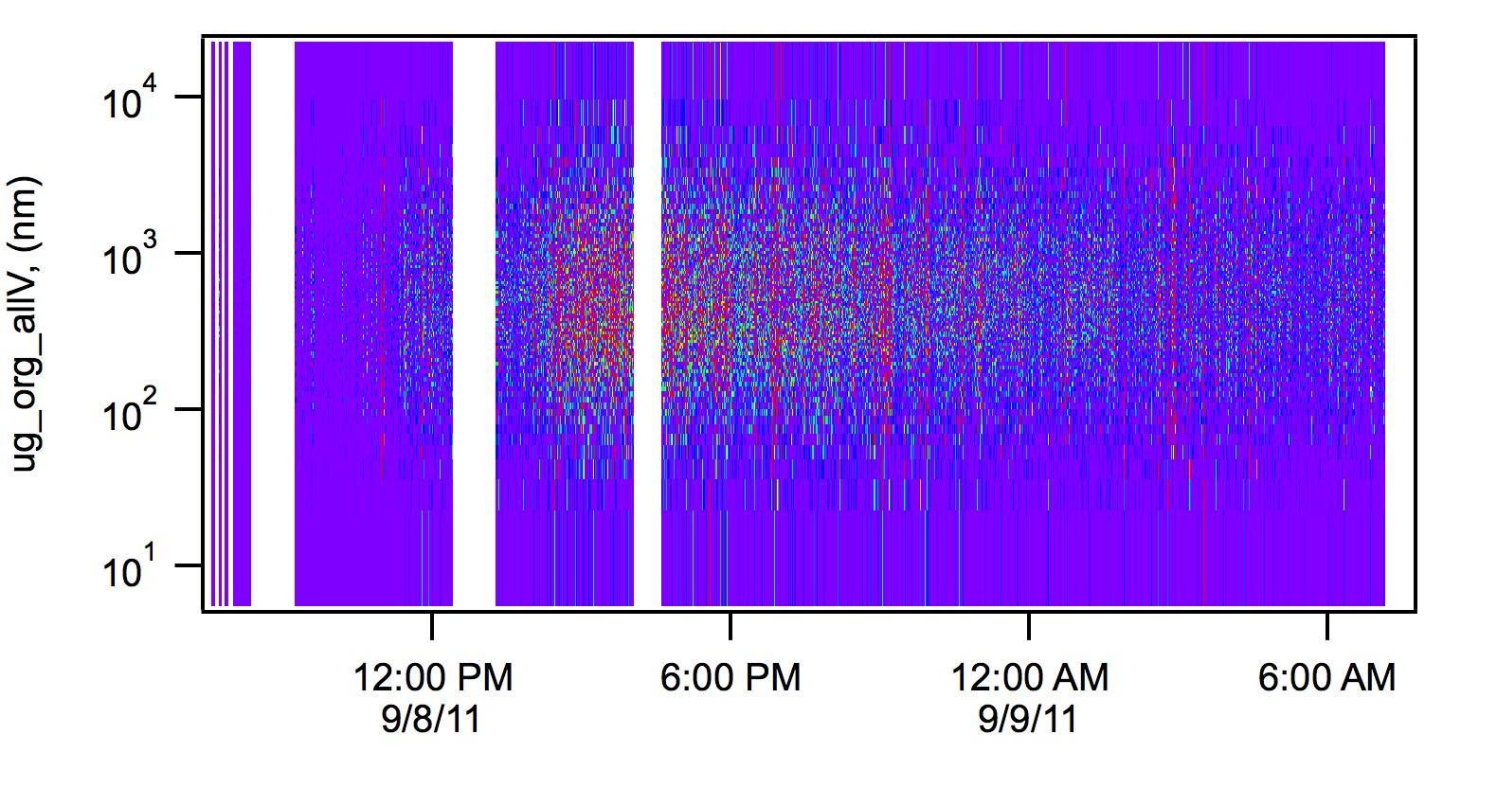
Peak Growth

Slide 2
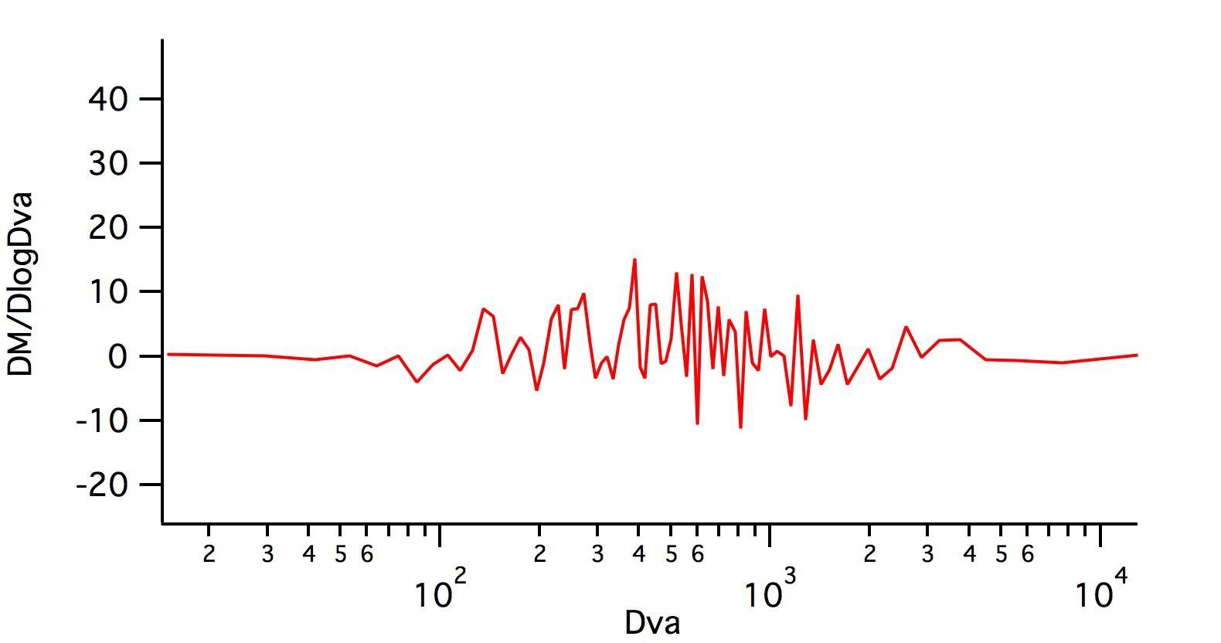
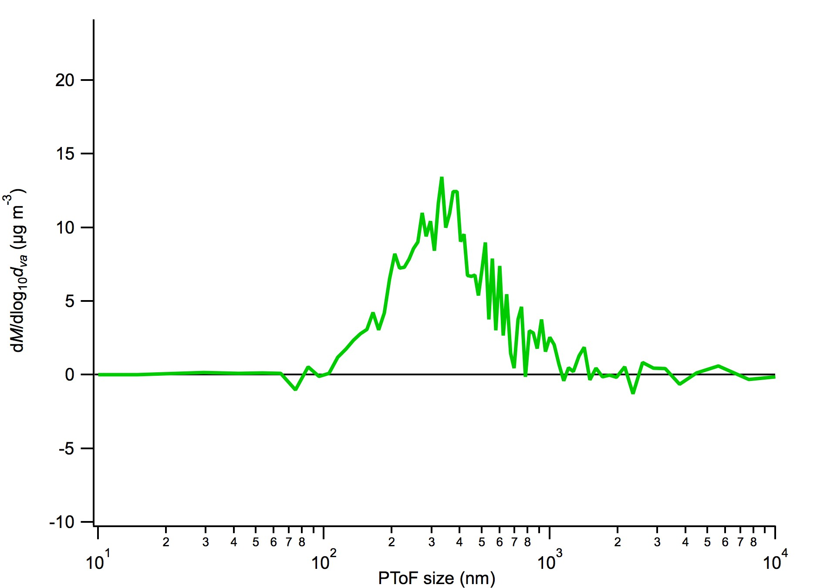
Saved from an image plot during
Peak Growth. The time stamp for the image plot is “as saved”
Saved in Squirell during Peak Growth (todo = PeakGrowthV).

Slide 3
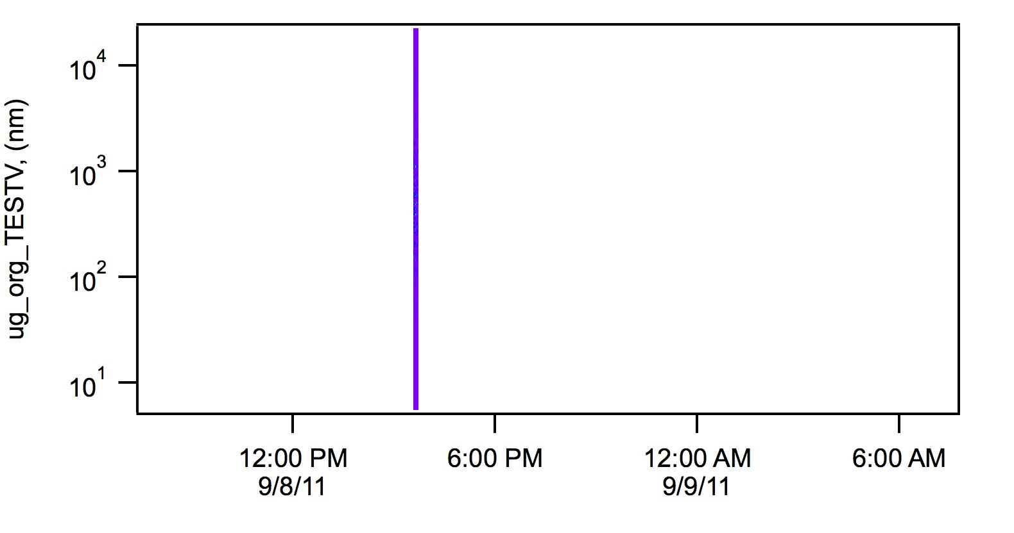
Todo = TESTV … Use this beast for calculations

Slide 4
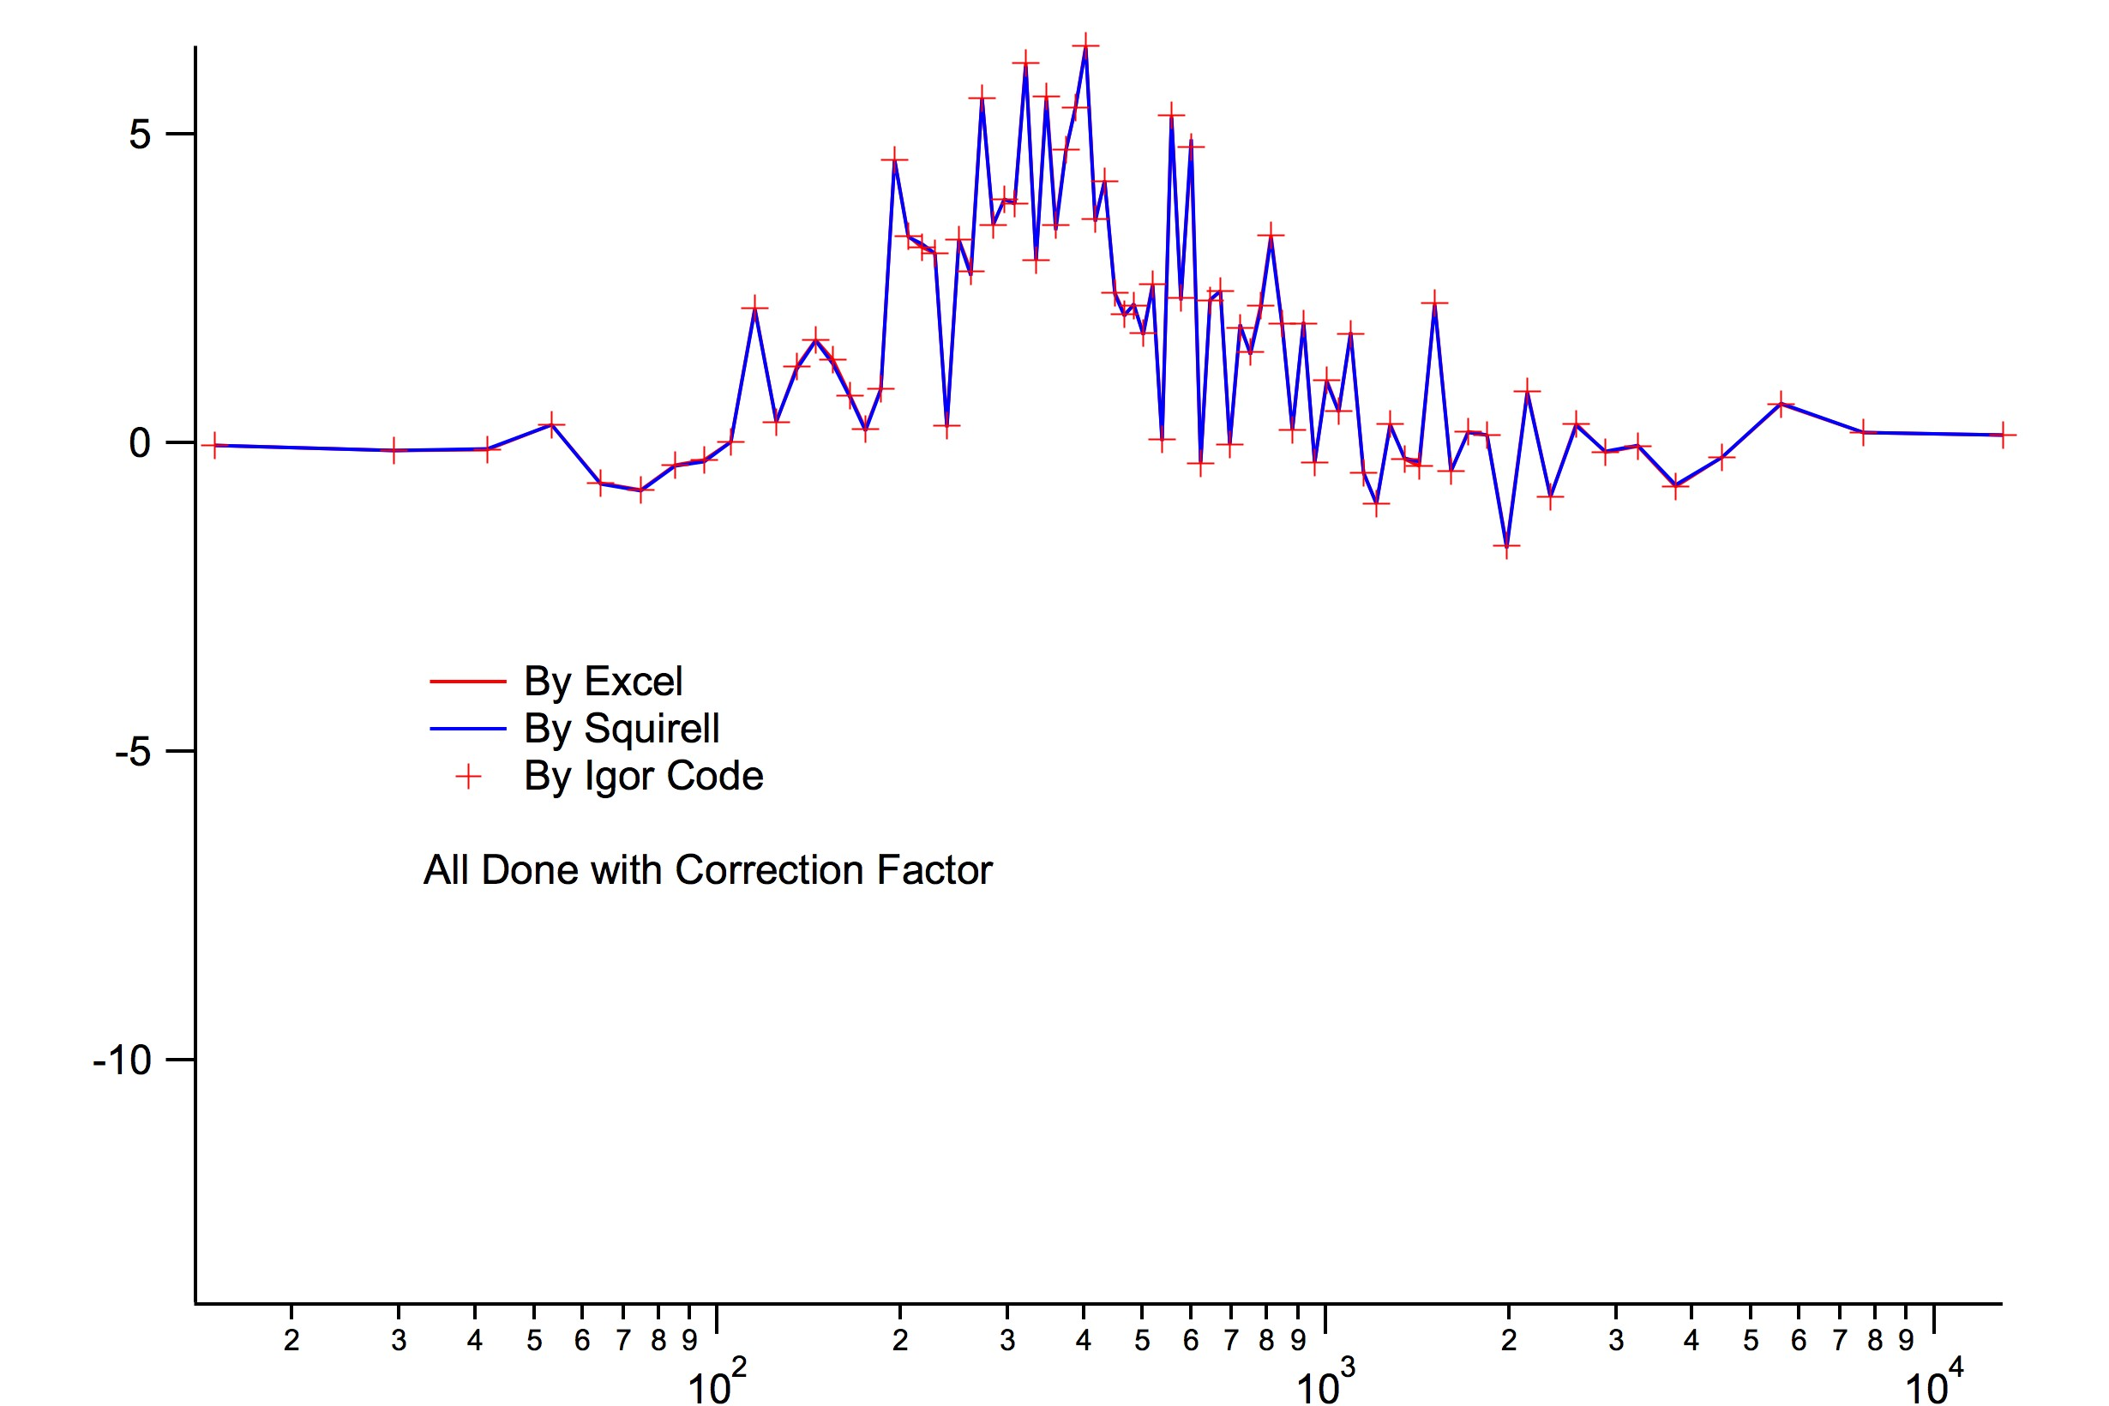
(using image plot)
(using image plot)
All Done WITHOUT Normalization Factor
Notes:
The three methods line up without normalization – the PToF structure is preserved

Slide 5
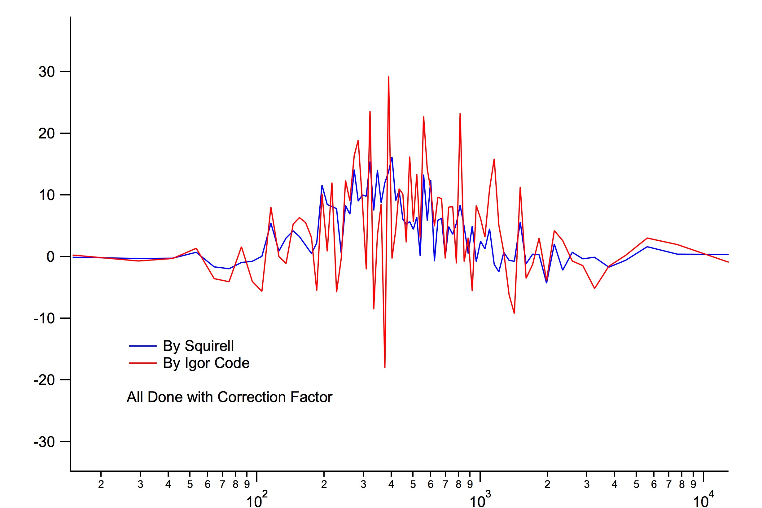
All Done WITH Normalization Factor
Notes:
When averaging from the image plot (“By Igor Code”) after applying the normalization factor, the structure of the PToF distribution is lost.

Slide 6
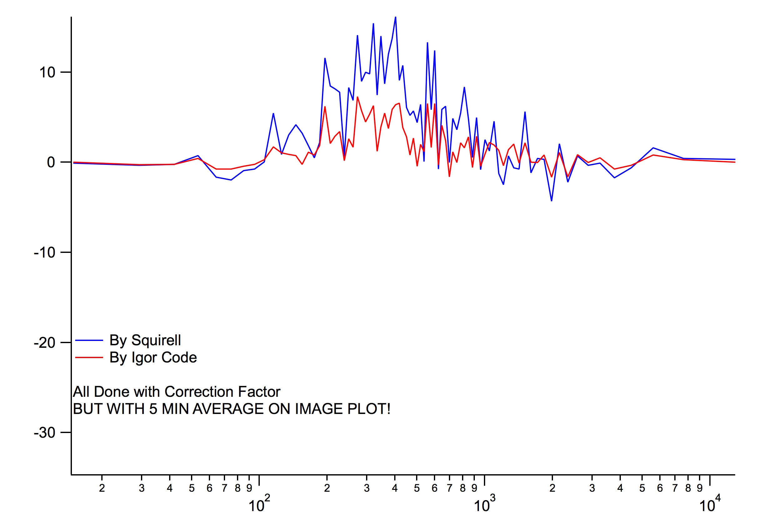
Notes:
When we average over a longer time period (5 min), we approach a structure that’s similar to the distribution calculated by Squirell.

Slide 7
Don’t use normalization factor when calc.
Image plot.
Add in the normalization factor AFTER you make the average from an image plot

