Slide 1
AMS Clinic4 V-mode Tuning & Frag Panels
Yu Jun Leong
(Griffin Lab, Rice University)

Slide 2
Problem
HR-ToF-AMS
Poor V-mode SQ data from DFW 2011
Goals:
Better understanding of IToF tuning
Improve V-mode and PToF data
Notes:
2nd bullet – (degree of frag panel adjustments) - W mode better – Donna Sueper’s input ITOF Tuning related

Slide 3
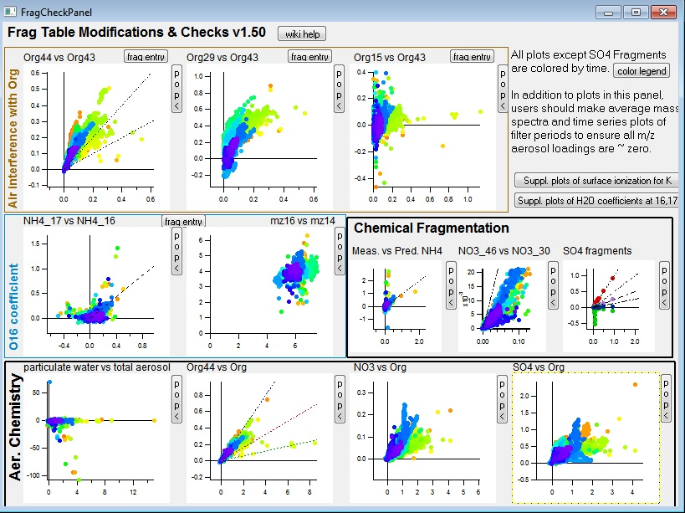
1. DFW: V-mode
Modifications:
Org44 v Org 43
= 0.27
Org29 v Org43
= 0.27
Org15 v Org43
= 1.00*
Tuning by Andrew Rutter – May 2011
Notes:
Mods:
CO2 contribution (mixing ratio of CO2 in air) – inverse w/ Org 44
N15N (in air) contribution – inverse w/ Org 29
N15 (in air) contribution – inverse w/ Org 15
O16 (in air) contribution – inverse w/ NH 16

Slide 4
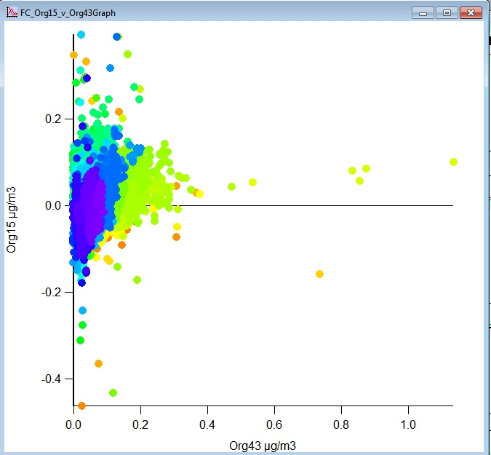
1. DFW: V-mode (cont)
Org15 vs Org43

Slide 5
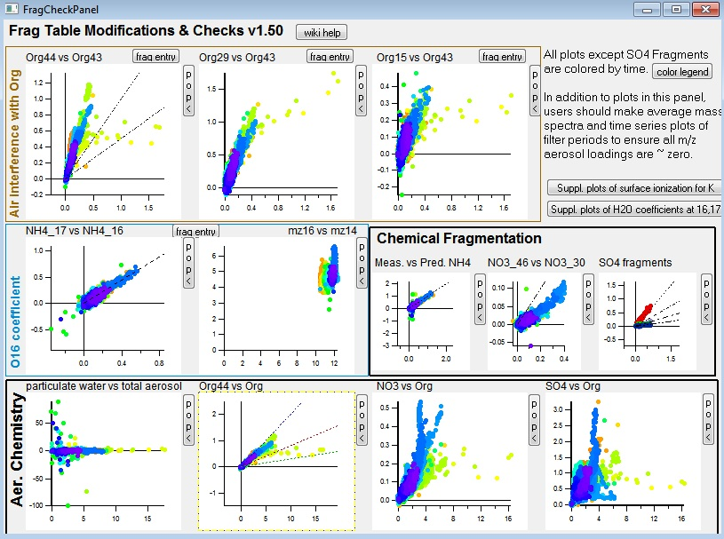
2. DFW: W-mode
Modifications:
Org44 v Org 43
= 0.95
Org29 v Org43
= 0.77
Org15 v Org43
= 1.05
Tuning by Andrew Rutter – May 2011

Slide 6
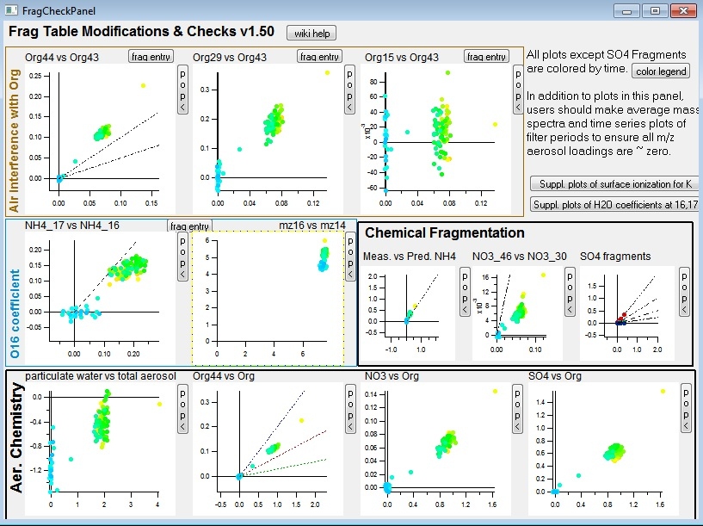
3. V-mode Test I
Modifications:
Org44 v Org 43
= 0.45
Org29 v Org43
= 0.48
Org15 v Org43
= 0.50
Aerodyne Training Tuning Voltages – June 2009
Notes:
V-test outside air coming in through lab inlet

Slide 7
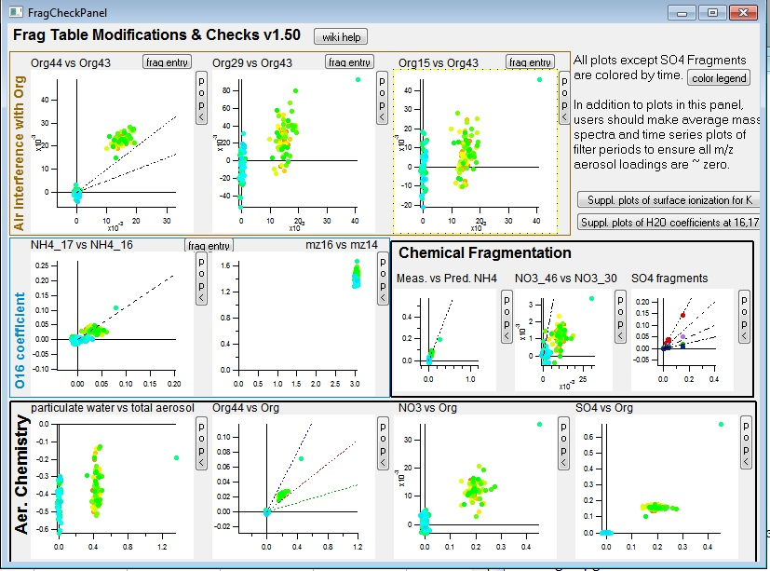
4. V-mode Test II
Modifications:
Org44 v Org 43
= 0.65
Org29 v Org43
= 0.61
Org15 v Org43
= 0.75
Last Known Good Tuning – February 2011
Notes:
Raw spectra
IE & AB for DFW – and from Aerodyne settings (Donna)

Slide 8
Questions
Is W-mode better tuned?
How best to proceed with tuning?
We have been using auto sweeping function
Based on voltages from Aerodyne in 2009

