Slide 1
HS Climate Resiliency Unit
Lesson 4

Slide 2
Do now
What did we figure out last class about albedo?
What does it help us explain?
What are some gaps that albedo doesn’t help us explain?
Notes:
1. (5 min) Have students work with a partner to answer the questions for their Do Now section.
Suggested Prompts:
What did we figure out yesterday about albedo?
What does it help us explain?
What are some gaps that albedo doesn’t help us explain?
Listen for student responses:
We figured out that albedo is the measure of how much light a surface reflects.
Albedo helps us explain urban heat islands where it gets hotter in places with surfaces that absorb heat like pavement.
It doesn’t help us explain why the temperatures are increasing more than normal in places like the Arctic which have high albedo.

Slide 3
Initial Ideas
What are we missing from our explanation?
How can we use our understanding of albedo to understand the increase in state temperature?
Notes:
2. (15 min) Guide students in an Initial Ideas Discussion^{A} to emphasize that what we know of albedo is not the entire explanation for increased temperatures using the following prompts.
Suggested Prompts:
What are we missing from our explanation?
How can we use our understanding of albedo to understand the increase in a state’s temperature?
Average state temperature trends are also increasing [refer to figure on slide] not just city temperatures, how can we explain this?
What is the difference between the “spikes” versus the overall trend line on this graph^{B}?
Listen for student responses:
Surfaces of states are changing too:
More/ growing cities causing lower albedo and more absorption.
Less snow for some reason = lower albedo, more absorption - like the ice albedo feedback we read about?
Estimate the albedo of the state land using our satellite imagery, and use it to calculate temperature.
Suggested Prompts:
Reviewing Colorado in Google Earth, we notice there is more rural space than urban spaces (cities) in Colorado, but the color of those surfaces are important too, even if they are not urban.
What percentage of the land would we categorize as “high albedo?” (ask students to assist in reviewing this terminology, being specific). What we are looking for when categorizing a high versus a low albedo surface?
How would this percentage translate to the albedo scale we read about yesterday? (The percentage will just be in decimal form, for example, 60% will become 0.6).

Slide 4
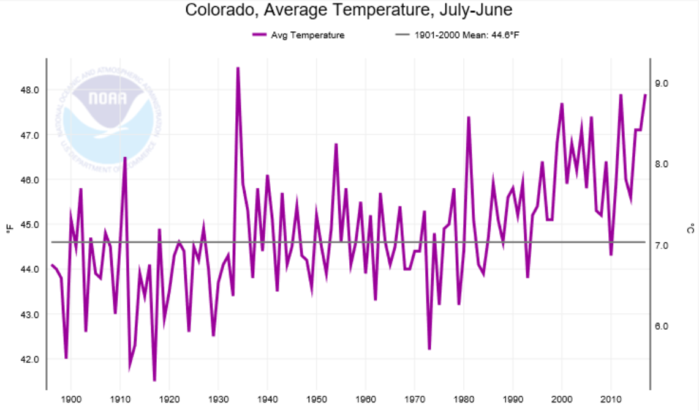
NOAA National Centers for Environmental Information
Notes:
2. (15 min) Guide students in an Initial Ideas Discussion^{A} to emphasize that what we know of albedo is not the entire explanation for increased temperatures using the following prompts.
Suggested Prompts:
What are we missing from our explanation?
How can we use our understanding of albedo to understand the increase in a state’s temperature?
Average state temperature trends are also increasing [refer to figure on slide] not just city temperatures, how can we explain this?
What is the difference between the “spikes” versus the overall trend line on this graph^{B}?
Listen for student responses:
Surfaces of states are changing too:
More/ growing cities causing lower albedo and more absorption.
Less snow for some reason = lower albedo, more absorption - like the ice albedo feedback we read about?
Estimate the albedo of the state land using our satellite imagery, and use it to calculate temperature.
Suggested Prompts:
Reviewing Colorado in Google Earth, we notice there is more rural space than urban spaces (cities) in Colorado, but the color of those surfaces are important too, even if they are not urban.
What percentage of the land would we categorize as “high albedo?” (ask students to assist in reviewing this terminology, being specific). What we are looking for when categorizing a high versus a low albedo surface?
How would this percentage translate to the albedo scale we read about yesterday? (The percentage will just be in decimal form, for example, 60% will become 0.6).

Slide 5
Initial Ideas
Average state temperature are also increasing, not just city temperatures, how can we explain this?
What is the difference between the “spikes” versus the overall trend line on the graph?
Notes:
Average state temperature trends are also increasing, not just city temperatures, how can we explain this?
What is the difference between the “spikes” versus the overall trend line on this graph? this question is really important. standard CCSS.Math.Content.HSS.ID.A.3 would be really great if the math was being taught at the same time. Talking about outliers and what they tell you (small scale changes that don't mean much long term etc) would enhance this study.
Listen for student responses:
Surfaces of states are changing too
- more/ growing cities causing lower albedo and more absorption?
Less snow for some reason = lower albedo, more absorption - like the ice albedo feedback we read about?
Estimate the albedo of the state land using our satellite imagery, and use it to calculate temperature?
Suggested Prompts:
Reviewing Colorado in Google Earth we notice there is more rural space than urban spaces (cities) in Colorado, but the color of those surfaces is important too, even if they are not urban.
What percentage of the land would we categorize as “high albedo?” (ask students to assist in reviewing this terminology, being specific what we are looking for when categorizing a high versus low albedo surface)
How would this percentage translate to the albedo scale we read about yesterday? (the percentage will just be in decimal form, for example 60% will become 0.6

Slide 6
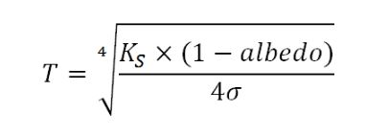
Calculating temperatures based on Albedo
T=Temperature in Kelvin
Notes:
3. [14 min] Hand out the Student Activity Sheet and read through the procedure. Break down the equation, going through each number and variable as the equation may seem daunting to students. Complete calculations^{B} to determine how changing the albedo of the State of Colorado might affect temperature. Each group/pair will complete a different albedo value to see how changing this value affects temperature, and this should be transcribed as a table on the board for students to copy into notes as calculations are completed (students complete on activity sheet)
Read equation introduction together (students popcorn read), noting what variables are present in the equation we are using and why they are important.
Determine what albedo ratings we want to explore as a class - one group should do the estimated “Colorado State” albedo, and from there students can choose higher and lower albedos to explore.
Circulate and support students with their calculations, instruct students to put their answer in Fahrenheit on the board next to their groups albedo value when completed. Students should copy data from board onto their student handouts.
Once students have compiled the class set of albedo data, guide them in a Building Understandings Discussion to summarize what the relationship between albedo and temperature is, and to compare the values we calculated with the average temperature of Colorado. Here students should note that even though albedo explains an increase in temperature, the temperatures we calculated are far below the state average.
Suggested Prompts:
What is the relationship between albedo value and temperature?
If albedo was decreasing in Colorado over time, could that result in an increase in temperature?
Does albedo fully explain the average temperature for Colorado? Why or why not?
Here, students should note that the albedo change in Colorado is far too small for the changes we see.
Listen for student responses:
The expected temperatures based on albedo are very low compared to the true temperature average of Colorado and we are wondering why?

Slide 7
Calculating temperatures based on Albedo
T=Temperature in Kelvin
Notes:
3. [14 min] Hand out the Student Activity Sheet and read through the procedure. Break down the equation, going through each number and variable as the equation may seem daunting to students. Complete calculations^{B} to determine how changing the albedo of the State of Colorado might affect temperature. Each group/pair will complete a different albedo value to see how changing this value affects temperature, and this should be transcribed as a table on the board for students to copy into notes as calculations are completed (students complete on activity sheet)
Read equation introduction together (students popcorn read), noting what variables are present in the equation we are using and why they are important.
Determine what albedo ratings we want to explore as a class - one group should do the estimated “Colorado State” albedo, and from there students can choose higher and lower albedos to explore.
Circulate and support students with their calculations, instruct students to put their answer in Fahrenheit on the board next to their groups albedo value when completed. Students should copy data from board onto their student handouts.
Once students have compiled the class set of albedo data, guide them in a Building Understandings Discussion to summarize what the relationship between albedo and temperature is, and to compare the values we calculated with the average temperature of Colorado. Here students should note that even though albedo explains an increase in temperature, the temperatures we calculated are far below the state average.
Suggested Prompts:
What is the relationship between albedo value and temperature?
If albedo was decreasing in Colorado over time, could that result in an increase in temperature?
Does albedo fully explain the average temperature for Colorado? Why or why not?
Here, students should note that the albedo change in Colorado is far too small for the changes we see.
Listen for student responses:
The expected temperatures based on albedo are very low compared to the true temperature average of Colorado and we are wondering why?

Slide 8
Calculating temperatures based on Albedo
T=Temperature in Kelvin
Notes:
3. [14 min] Hand out the Student Activity Sheet and read through the procedure. Break down the equation, going through each number and variable as the equation may seem daunting to students. Complete calculations^{B} to determine how changing the albedo of the State of Colorado might affect temperature. Each group/pair will complete a different albedo value to see how changing this value affects temperature, and this should be transcribed as a table on the board for students to copy into notes as calculations are completed (students complete on activity sheet)
Read equation introduction together (students popcorn read), noting what variables are present in the equation we are using and why they are important.
Determine what albedo ratings we want to explore as a class - one group should do the estimated “Colorado State” albedo, and from there students can choose higher and lower albedos to explore.
Circulate and support students with their calculations, instruct students to put their answer in Fahrenheit on the board next to their groups albedo value when completed. Students should copy data from board onto their student handouts.
Once students have compiled the class set of albedo data, guide them in a Building Understandings Discussion to summarize what the relationship between albedo and temperature is, and to compare the values we calculated with the average temperature of Colorado. Here students should note that even though albedo explains an increase in temperature, the temperatures we calculated are far below the state average.
Suggested Prompts:
What is the relationship between albedo value and temperature?
If albedo was decreasing in Colorado over time, could that result in an increase in temperature?
Does albedo fully explain the average temperature for Colorado? Why or why not?
Here, students should note that the albedo change in Colorado is far too small for the changes we see.
Listen for student responses:
The expected temperatures based on albedo are very low compared to the true temperature average of Colorado and we are wondering why?

Slide 9
Calculating temperatures based on Albedo
What should the average temperature should be for our state based on the albedo we estimated for Colorado?
Does that sound correct for what is actually is?
Notes:
4. (5 mins) Return to the driving questions board to determine the missing variable (greenhouse gases). The goal of this section is to get students thinking about the role of gases with temperature- whether in the form of emissions (greenhouse gases), or simply drawing on what they know about the carbon cycle with plants.
Suggested Prompts:
Based on the albedo we estimated for Colorado, the average temperature should be ___________ for our state. Does that sound correct for what is actually is? Why is this average low? Is something missing from our equation?
What from our driving questions board might help us understand another variable that influences temperature?
What are greenhouse gases, how do they affect temperature?
Are all gases greenhouse gases? Which are and which are not?
Listen for student responses:
From driving questions board, photosynthesis, emissions, greenhouse gases should attract student attention. Use these to build toward goal
Greenhouse gases trap heat, we don’t specifically know how
Not all gases are greenhouse gases, 02 N2 are not, C02 and methane are… we don’t know about water vapor

Slide 10
Next Steps
What could we do to investigate this idea of greenhouse gases?
Notes:
5. (5 min) Ask student to brainstorm in a whole class discussion or a think pair share, what our next steps should be in our investigations.
Suggested Prompts:
What could we do to investigate this idea of greenhouse gases?
How could we answer our questions?
Listen for student responses such as:
We think both land type (albedo) and emissions (greenhouse gases, the atmosphere) have something to do with this so we decided to look at both of these relative contributions.
We need to figure out how greenhouse gases trap heat.
We need to determine the sources of greenhouse gases and if these sources are changing/increasing.

Slide 11
Greenhouse Gases
What gases are in this room right now?
What gases are produced by living organisms?
What gases are considered “emissions” from our Driving Questions board?
What are emissions and what affects them?
What percentage does each of these gases make up of our atmosphere?
Notes:
6. (5 min) Now that students have determined that it’s not just albedo that affects temperature, but also the gases in Earth’s atmosphere, have students complete the gases table in their Student Activity Sheets to determine what prior knowledge they have.
Suggested Prompts:
What gases are in this room right now?
What gases are produced by living organisms?
What gases are considered “emissions” from our Driving Questions board
What are emissions and what affects them?
What are emissions and what affects them?
Ask students to share their ideas and create a class list of things we know about gases in our atmosphere, organizing these observations on the board.
Listen for and capture student responses, such as:
Oxygen, animals use it to respire… byproduct of photosynthesis
C02 - people exhale it, plants use it for photosynthesis
C02- emissions from cars, factories, burning fossil fuels, which make energy for humans to use (really important to make sure students bring up)
Methane - cows
Water vapor - from evaporation of water, clouds

Slide 12
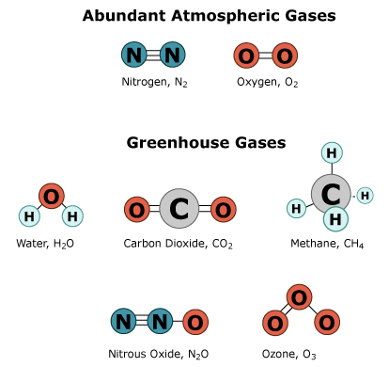
Notes:
7. (25 min) At this point, it should be clear that there is disparity in what students know/understand about greenhouse gases and how they work. Use this to motivate the need for some type of activity to help students understand greenhouse gases. Then, introduce “greenhouse gas” computer simulations (there are 2) and how they will demonstrate how greenhouse gases interact with energy from the sun. Instruct students to use their Student Activity Sheets and the Simulation Help Handout to complete the simulation.

Slide 13
Develop a Model
How do Greenhouse Gases affect Earth?
Notes:
8. (15 mins) Have students create models on poster paper (using markers to help illustrate the different types of energy) where they explain how the greenhouse effect works on planet earth, following the directions in their Student Activity Sheet. They must have labeled steps on these posters (at least 5 steps), they must use all the vocabulary terms listed, and the posters will be submitted for an assessment. Remind students to not get focused on artistry, focus on content. Circulate between groups to provide feedback/support/ help them extend thinking.

Slide 14
Making Sense and Building Understandings
Answer the questions in your Student Activity Sheet
Notes:
9. (15 mins) Once students have had a chance to complete their models, direct them to answer the Making Sense questions in their Student Activity Sheets and then guide students in a Building Understandings Discussion.
Suggested Prompts:
Which of the gases we’ve explored today are greenhouse gases? How do you know?
Why are they called greenhouse gases, why is this called the greenhouse effect?
Are greenhouse gases bad?
Listen for student responses
The most important greenhouse gases are C02, Methane, and water vapor… these molecules seem to have more than one element present… “lopsided polarity” and can trap infrared heat. N2 and 02 cannot.
Similar to a greenhouse which is a glass/plastic structure where visible light can enter through glass, be absorbed and changed to infrared heat, and then trapped in the greenhouse. Warms the greenhouse so plants can grow there even in the winter.
Greenhouse gases are not bad, but too many greenhouse gases trapping an excessive amount of heat could be bad.
Suggested Prompts:
Are greenhouse gases increasing in Colorado?
What could cause greenhouse gas concentrations to change in Colorado?
What are sources of greenhouse gases (identify natural versus anthropogenic)
Are greenhouse gases increasing in Colorado? Why
What evidence might we look for in Colorado that temperature is changing?
Listen for student responses
C02 has a natural yearly cycle in Colorado, lower when more photosynthesis is taking place. This cycle is in equilibrium.
In Colorado - more forest fires, trees dead from pine beetle, cutting down forests, more people consuming more fossil fuels, bigger cars, larger cities.
There are human-caused sources of C02 that might be disrupting this balance. We’ve heard of “fossil fuels” releasing c02, we know our cars release emissions, and methane comes from cows.
Human population is increasing worldwide, so greenhouse gases being emitted could be increasing too.
Less snowpack, warmer summers, changing ecosystems
Suggested Prompts:
What is the temperature trend for the USA… for the world?
Are all locations in the USA warming at the same rate? What might account for these regional differences?
Is everywhere in the world warming at the same rate? What might account for these regional differences?
Listen for student responses
Overall trend is the world is getting warmer, and this might relate back to greenhouse gases
There are regional differences in warming
oceans/albedo might have a role

Slide 15
Consensus Building
What have we figured out so far?
Notes:
10. (5 min) Use the following prompts to guide students in a Consensus Building Discussion.
Suggested Prompts:
What have we figured out so far?
What is our reaction to increasing worldwide temperatures?
What should our next steps be in our investigation?
Listen for student responses such as:
We figured out how the greenhouse effect works and that temperatures are increasing all over the world, including Colorado.
Has this period of warmer temperature/ higher C02 happened before in Earth’s history? Is this normal?
How is increasing global temperatures dangerous, what can happen?
for how long have temperatures been increasing?How long has this been going on
Record and post what we figured out and what we are wondering from this closing discussion.

Slide 16
Questions
What are we wondering?
What questions should we answer next?
Notes:
What should our next steps be in our investigation?

