Slide 1
What’s up with the rising temperatures in Colorado cities?
Lesson 1

Slide 2
We will watch a video clip about these cities.
Notes:
Link to the video clip: http://www.denverpost.com/2016/07/14/colorado-summers-getting-hotter-stickier/ (Stop video at 50 seconds - before they get into the explanation about why the cities are getting hotter!)
Video is also available on YouTube (https://www.youtube.com/watch?v=fVo5V-NtlHA) if the above link does not work.

Slide 3
The first time we watch the clip, just listen. The second time, write your questions and ideas on your Student Activity Sheet.
Notes:
(10 min) Watch the video twice (stop video at 50 seconds mark - before explanations about why this might be happening). The first time, the students can watch and listen. The second time through, have them individually write down some initial thoughts and questions they have about the video on their Student Activity Sheet.
Suggested Prompts:
What do you want to know about these cities? Write your questions on your Student Activity Sheet.
Do you have any ideas about what is going on in these cities? Write your ideas on your Student Activity Sheet.
Does the video make you wonder about anything in particular? Write your ideas on your Student Activity Sheet.
Possible student responses to the video:
Why are these cities hotter?
The cities are hotter because the world is getting hotter. I saw that on TV.
We think that cities are getting hotter, because they have less shade.

Slide 4
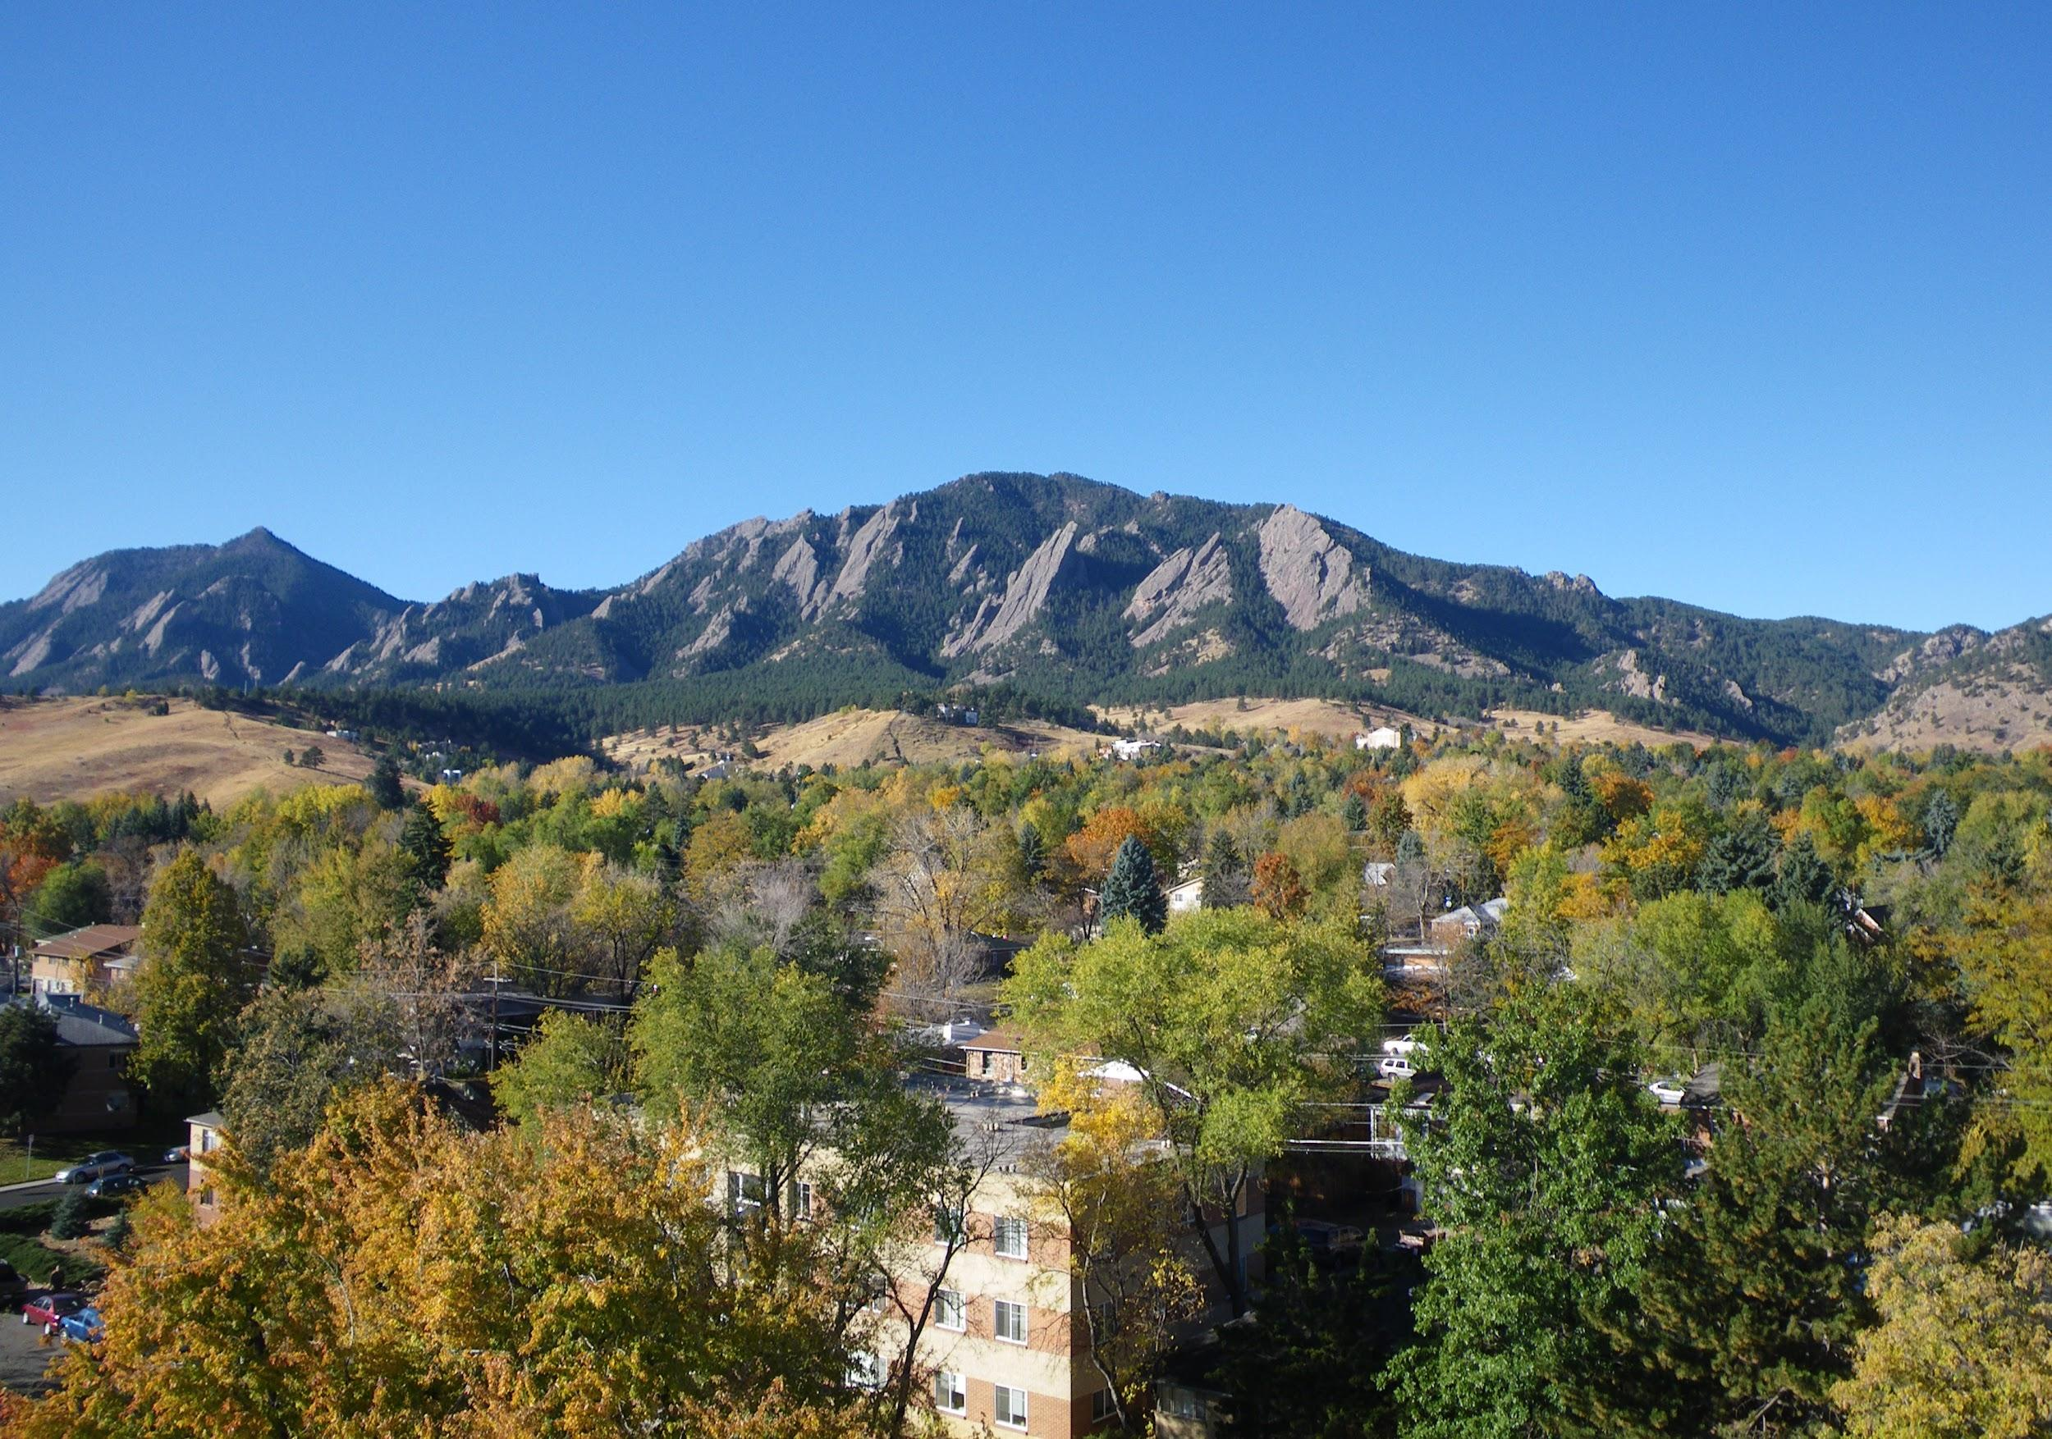
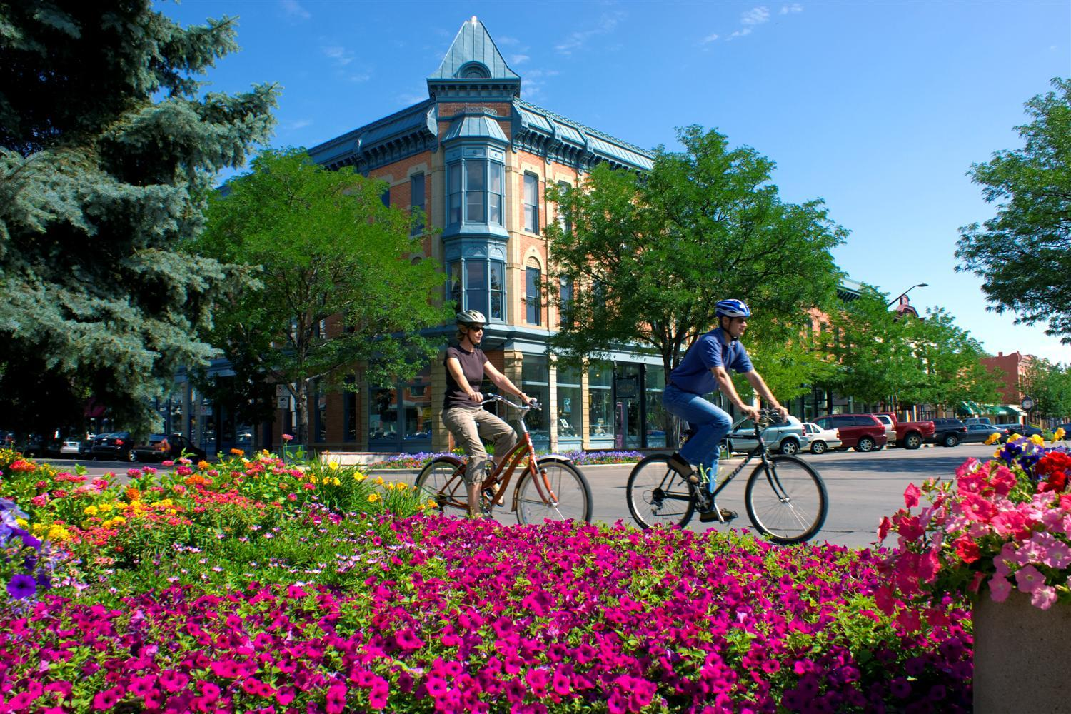
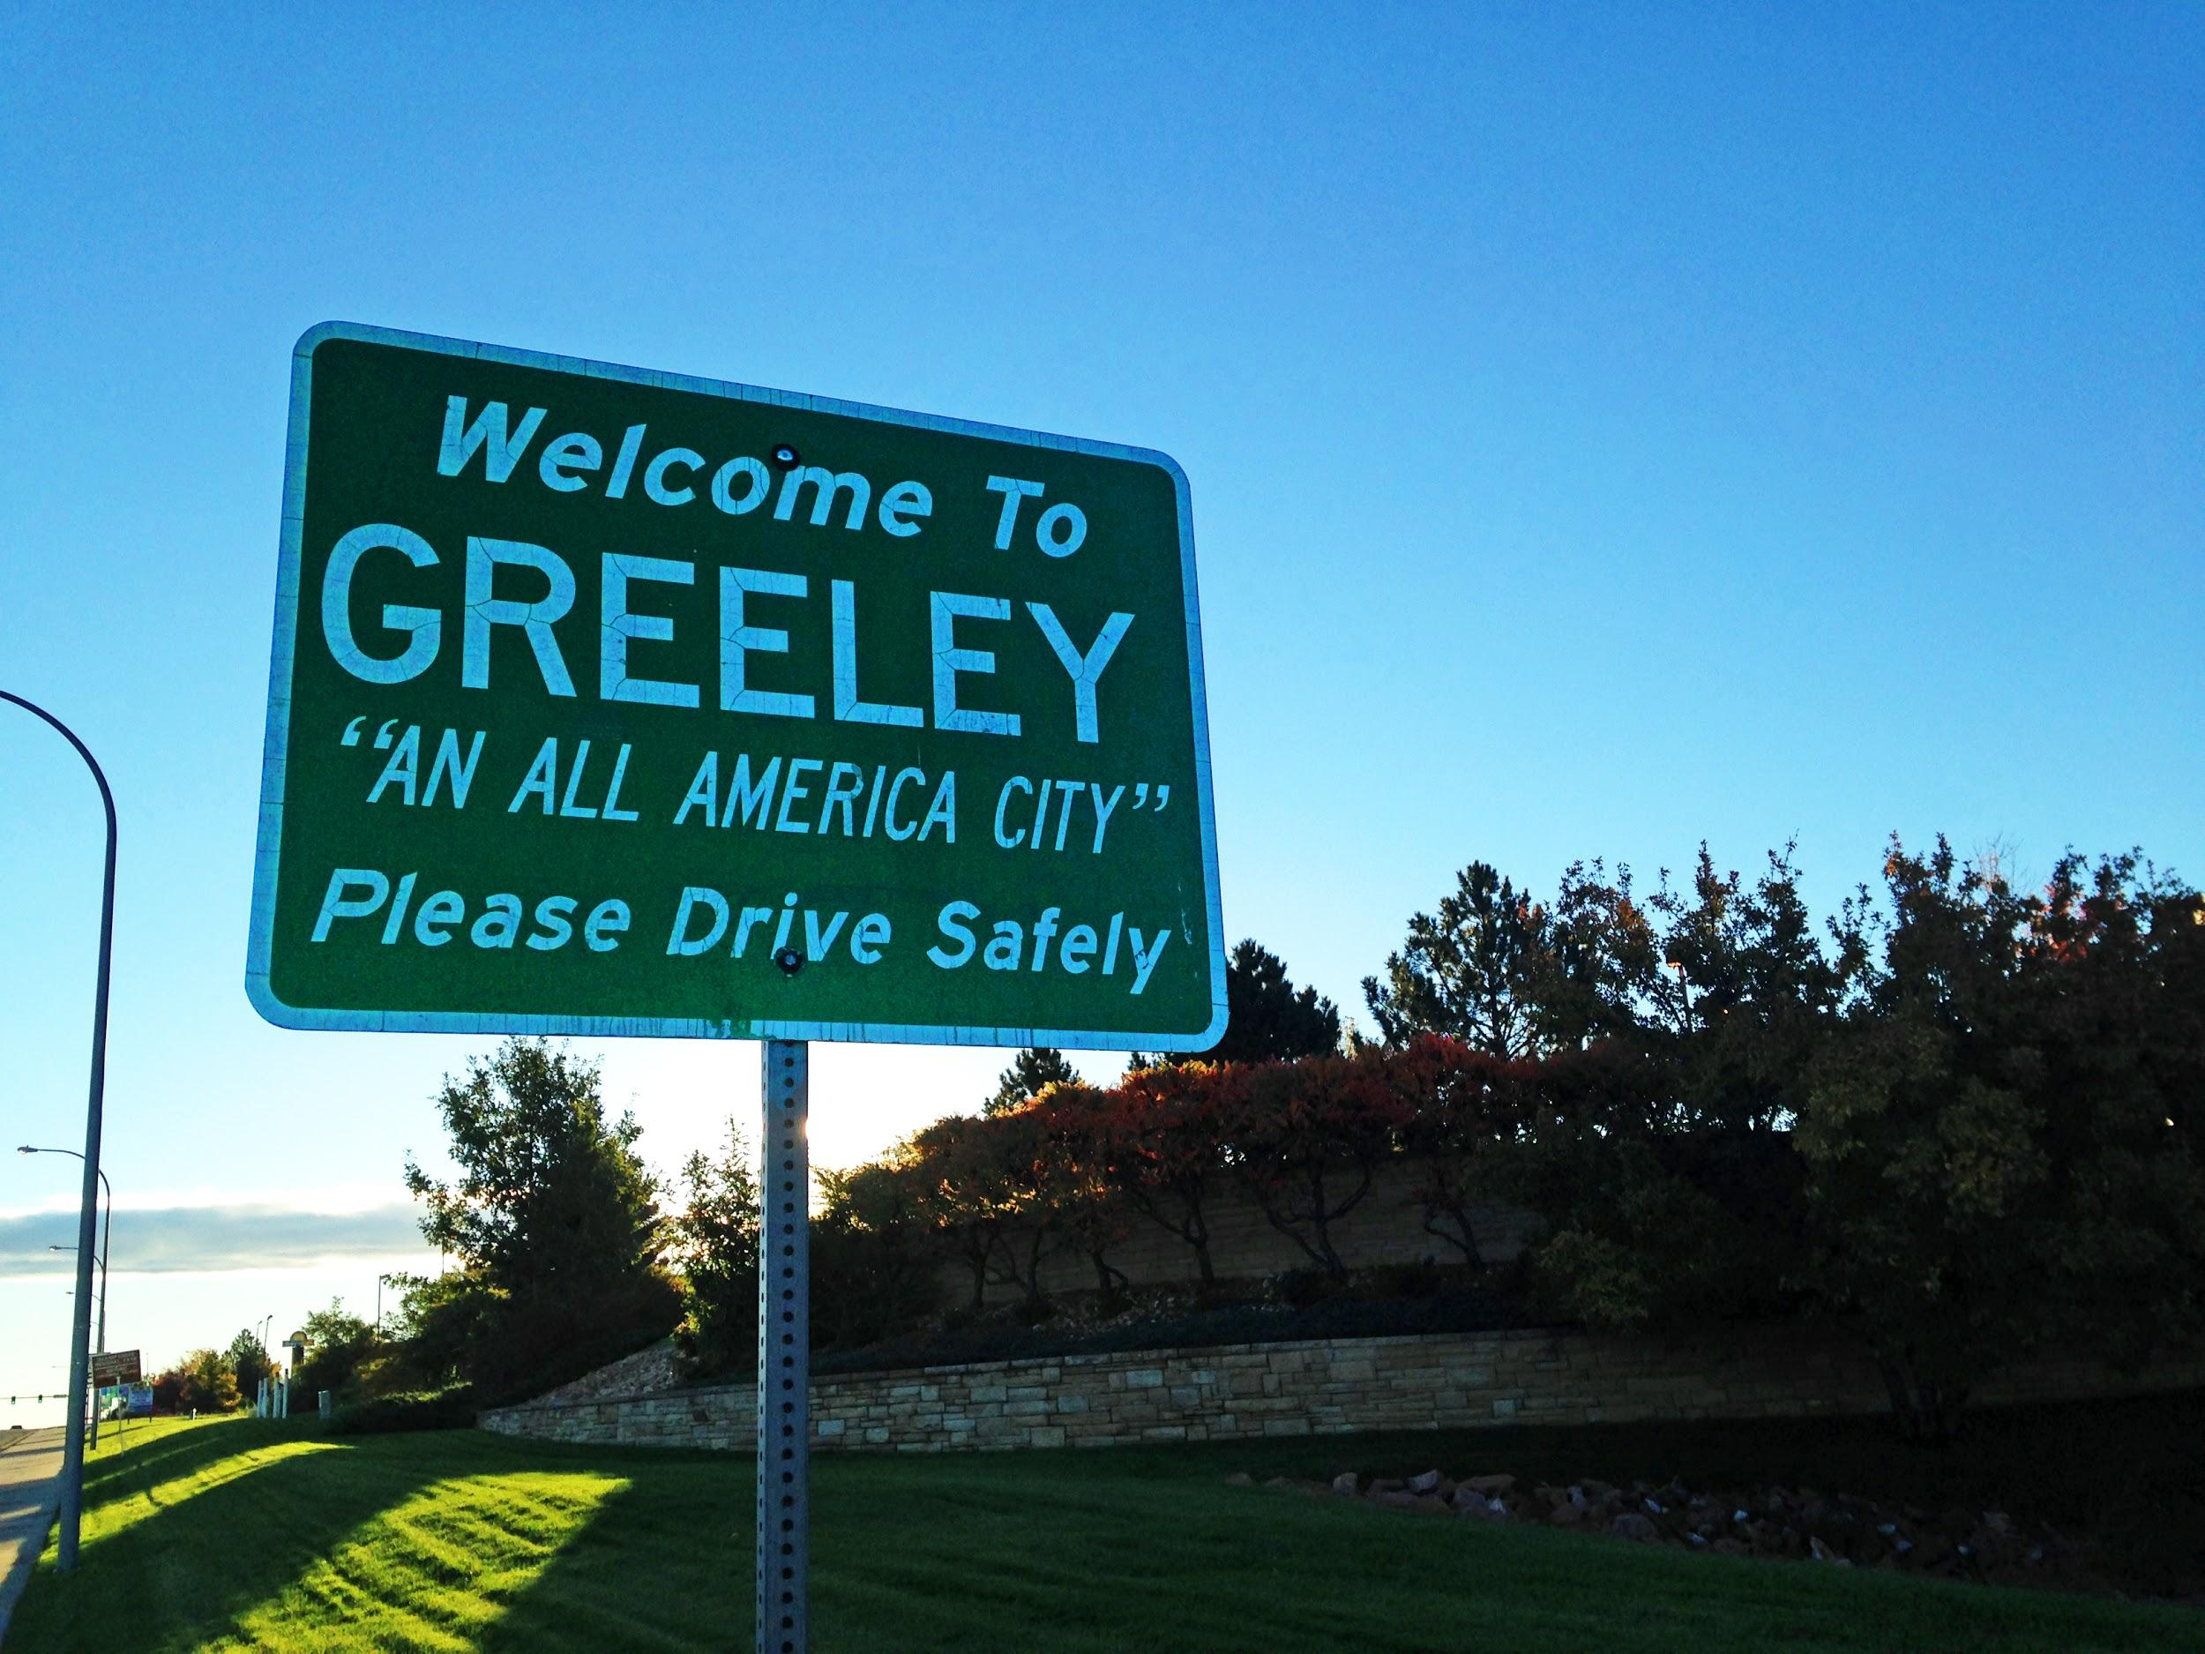
There are three cities in Colorado that are experiencing a large rise in temperature.
Notes:
(10 min) Watch the video twice (stop video at 50 seconds mark - before explanations about why this might be happening). The first time, the students can watch and listen. The second time through, have them individually write down some initial thoughts and questions they have about the video on their Student Activity Sheet.
Suggested Prompts:
What do you want to know about these cities? Write your questions on your Student Activity Sheet.
Do you have any ideas about what is going on in these cities? Write your ideas on your Student Activity Sheet.
Does the video make you wonder about anything in particular? Write your ideas on your Activity Sheet.
Possible student responses to the video:
Why are these cities hotter?
The cities are hotter because the world is getting hotter. I saw that on TV.
We think that cities are getting hotter, because they have less shade.

Slide 5
What were some of your questions and ideas?
Why is each city getting a different amount of heat? (Jordan)
Why does it get hotter in the summer? (Dom)
How does it get hotter in the summer? (Dom)
What’s the hottest it’s gotten on average? (Jordan)
Will it get hotter than it is now? (Jordan)
When does it get hotter in summer on specific days? (Dom)
Notes:
2. (20 min) Next, shift to a Sharing Initial Ideas Discussion ¹. Write the students’ questions and ideas on the Driving Questions Board² (this can be projected online or on butcher paper). Use the following prompts to guide students to articulate what they think they should focus on in this unit.
Suggested Prompts:
What do you think is going on that explains what the video told us?
Do you have any ideas about what might be going on in these cities?
What questions would we need to answer as a class, to figure out why these cities seem to be getting hotter?
Listen and write student responses on the Driving Questions Board² that mimic the next step in the storyline, such as:
Why these cities?
Where are the cities that are getting hotter?
Are they just in Colorado?
What’s special about the cities where it’s getting hotter compared to the ones where it’s not?
Was it always this hot?
Is this unusual or a pattern? For how long?
If it’s a pattern, is the pattern just here in CO, or elsewhere?
What does “global warming” have to do with it?
What’s causing the pattern?
We have some hypotheses about this we want to investigate:
What do parking lots and other things that are in cities have to do with it?
Do cars have anything to do with it?
What about greenhouse gases?
What might pollution have to do with it?
If there’s more people, is there more pollution, and does that matter for the pattern?

Slide 6
Which questions are so similar we can get rid of them?
Notes:
2. (20 min) Next, shift to a Sharing Initial Ideas Discussion ¹. Write the students’ questions and ideas on the Driving Questions Board² (this can be projected online or on butcher paper). Use the following prompts to guide students to articulate what they think they should focus on in this unit.
Suggested Prompts:
What do you think is going on that explains what the video told us?
Do you have any ideas about what might be going on in these cities?
What questions would we need to answer as a class, to figure out why these cities seem to be getting hotter?
Listen and write student responses on the Driving Questions Board² that mimic the next step in the storyline, such as:
Why these cities?
Where are the cities that are getting hotter?
Are they just in Colorado?
What’s special about the cities where it’s getting hotter compared to the ones where it’s not?
Was it always this hot?
Is this unusual or a pattern? For how long?
If it’s a pattern, is the pattern just here in CO, or elsewhere?
What does “global warming” have to do with it?
What’s causing the pattern?
We have some hypotheses about this we want to investigate:
What do parking lots and other things that are in cities have to do with it?
Do cars have anything to do with it?
What about greenhouse gases?
What might pollution have to do with it?
If there’s more people, is there more pollution, and does that matter for the pattern?

Slide 7
What question do we need to answer first, and why?
Notes:
3. (15 min) In a Generating and Prioritizing Questions discussion, ask representatives from each group to explain the rationale for choosing the 3 questions that they chose. As a class, choose the most critical questions that need to be answered to get to the bottom of this phenomenon.
Suggested Prompts:
Which questions do you think we have to answer in order to figure out why this is happening in these cities? Why are those questions important to answer?
What questions need to be answered first, because the answers will inform other questions we have?
Possible student responses to record on a class Driving Questions Board :
Why these cities?
Is this really a pattern?
What’s causing the pattern?
We need to know what’s different about these cities first, because it may have clues for other things.
We can’t be sure this is a pattern, so there’s no point in studying the cause before we know it’s a real long-term pattern.

Slide 8
A representative will share your group’s top 3 questions and your rationale behind choosing those three.
Notes:
3. (cont.) As a class, choose the three most critical questions that need to be answered to get to the bottom of this phenomenon.
Suggested Prompts:
Which three questions do you think we have to answer first in order to investigate why this is happening in these cities? Write your top three questions on your Student Activity Sheet.
Possible student responses for the Driving Questions Board:
Why these cities?
Is this really a pattern?
What’s causing the pattern?

Slide 9
What have we decided are our priority questions for our Driving Questions Board?
Notes:
3. (cont.) As a class, choose the three most critical questions that need to be answered to get to the bottom of this phenomenon.
Suggested Prompts:
Which three questions do you think we have to answer first in order to investigate why this is happening in these cities? Write your top three questions on your Student Activity Sheet.
Possible student responses for the Driving Questions Board:
Why these cities?
Is this really a pattern?
What’s causing the pattern?

