Slide 1
What makes cities hotter?
Lesson 2

Slide 2
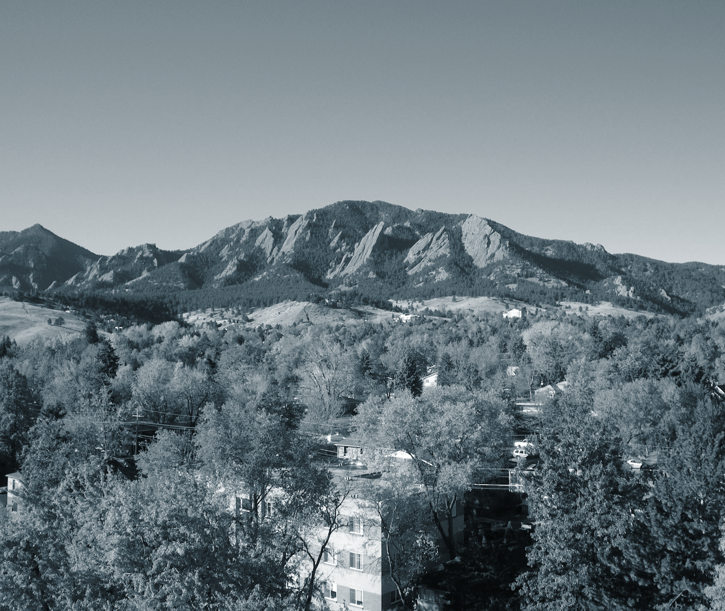
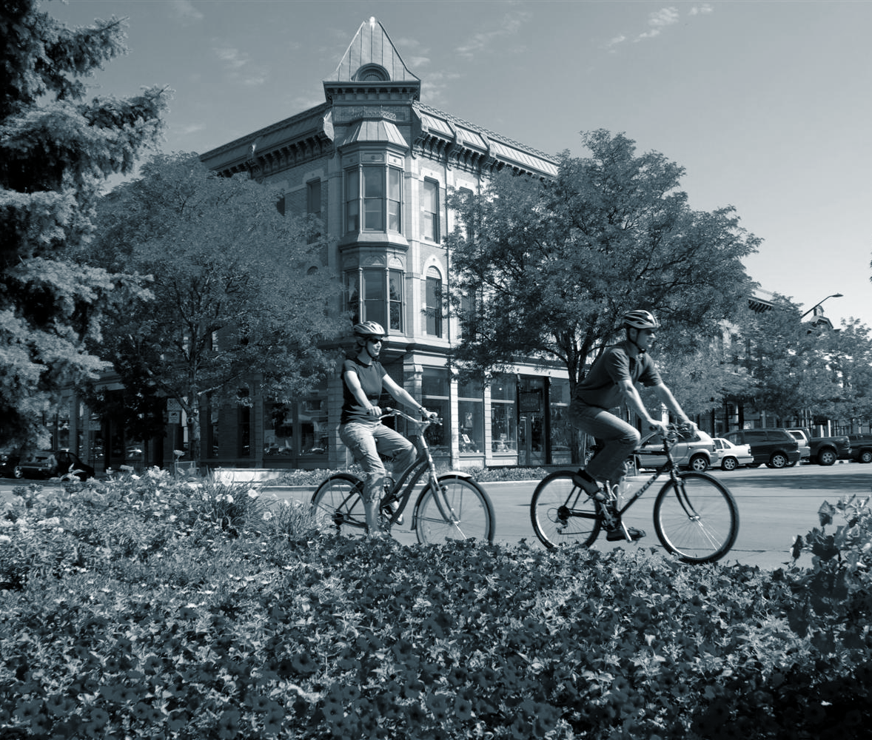
What did we wonder about last class?
Notes:
1. (10 min) Begin with a Consensus Building Discussion ¹ to help remind students what they discussed in the last class. Students should engage in a think-pair-share discussion format at first, and then discuss the questions as a whole class. Use the following prompts to help students articulate what they figured out in the last lesson.
Suggested Prompts:
What did we wonder about last class? (refer to “Driving Questions Board”)
We had some ideas about how to investigate our questions. What were our ideas?
Which questions did we decide were the most important to investigate first?
Listen for student responses ² that refer to what we figured out last time, such as:
We figured out that there are three cities in Colorado that are experiencing higher temperatures on average than other cities.
We asked three main questions: Why these cities? Is this really a pattern? What’s causing the pattern?

Slide 3
What were our ideas about the rising temperatures?

Slide 4
Which questions did we decide to investigate?

Slide 5
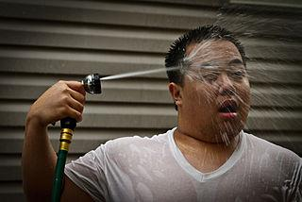
What do you think is causing these cities to get hotter?

Slide 6
How could we investigate your ideas about what’s causing these cities to get hotter?
Notes:
2. (15 min) Next, shift to a Sharing Initial Ideas Discussion ³. Students should engage in a think-pair-share discussion format at first, and then discuss the questions as a whole class. Use the following prompts to guide students to articulate what they think they should focus on in today’s lesson.
Suggested Prompts:
What do you think is causing these cities to get hotter?
How kinds of data would we need to help us decide what’s causing the cities to get hotter?
What can we look for in the data in order to determine whether that phenomenon is causing the cities to get hotter?
How can we figure out if a pattern or correlation between two variables is there? How do we know if it is going up or down?
Listen for student responses and ideas about how to determine what these three cities have in common, what is causing the rising temperatures, and how we can determine what’s causing it:
Is because of the population that these cities are so hot?
Is stuff happening like fires that could make it hotter?
Is it that these places are just sunnier?
We can look at graphs showing us information about fires, population, and sun and we can see if they’re the causes of the cities getting hotter.
We can look at whether there are more fires over the past 50-100 years, whether there was more sunshine over the past 50-100 years, and whether there were more people moving to these cities over the past 50-100 years?
We will be able to determine whether the pattern or correlation is going up or down by looking at the data and if there’s more or less fires happening, more or less days of sun happening, or more or less people moving there over the last 50-100 years.

Slide 7
What will a graph of the data look like, if the two things we are looking at are related (e.g. sunshine & temperature)?

Slide 8
What pattern do we see in the data?

Slide 9
Does the pattern show a relationship between the things we’ve been looking at?

Slide 10
Now you will use data to analyze about the following 3 things:
Population
Temperature
Precipitation
...in Greeley, Boulder, Denver, Fort Collins, Greeley, and Pueblo, Colorado.
Notes:
3. (25 Minutes) Hand out the datasets for population, temperature and precipitation to each team of 3 or 4 students and hand a Student Activity Sheet to each student⁴ . They will work in teams but each of them will complete their own Student Activity Sheet. They are looking for patterns and trying to figure out whether there is evidence for their hypotheses about the cause of the rising temperatures in Greeley, and Fort Collins, Colorado.
Suggested Prompts (Ask Groups While Circling the Room):
What patterns in the data should you be looking for, given your hypothesis about what’s causing the temperatures to rise more in these three cities?
Do you see the patterns you expect to see? If so, how does that support your hypothesis? If not, what does that tell you about that phenomenon and the rising temperatures in the three cities?
There’s a lot of “noise” in the data: what can you do to help you see the pattern in the data? How can you be convinced there’s a pattern, and that the numbers are not random?
Listen for student responses as they do their data analysis:
We see an upward pattern for population growth in these cities. They appear to be growing faster than some of the other cities on the list. That could be contributing to the rising temperatures.
Temperatures have changed in most places, getting warmer.
Precipitation is generally small amount each month.

Slide 11
Fill out your Student Activity Sheet as you work with your team!

Slide 12
Did you see any patterns or relationships?
Notes:
4. (5 min) When students have completed the data analysis, bring them back together as a whole group, having team members sit close to one another. In this Building Understandings Discussion, use the following prompts to help students debrief what they learned with their data analysis.
Suggested Prompts:
Did you see any patterns? If so, what patterns did you see? If not, what does that tell you about that phenomenon and the rising temperatures in the three cities?
(For GT Students: What does the the line of best fit tell you?) Are the patterns upward or downward? If not, what can you conclude about that phenomenon and the rising temperatures in the three cities?
Listen for student responses as they do their data analysis:
We saw an upward pattern for population growth in these three cities. That could be contributing to the rising temperatures.
A majority of cities had an increase in temperature for both max and min temperatures
Precipitation has increased slightly for most cities.

Slide 13
If so, what patterns or relationships did you see? If not, you still learned something. What?

Slide 14
Do you see upward patterns or relationships? Downward patterns or relationships? What does that tell you?

Slide 15
What should we investigate next?
Notes:
5. (5 min) Ask students to brainstorm what our next steps should be in our investigations.⁵
Suggested Prompts:
What questions from our Driving Questions Board can we answer now?
What new questions arose for us from our investigation today that we might need to add to the Board?
What should make sure to do in our next class?
What do we need to investigate next time we meet for science?
Listen for student responses such as:
We figured out that these cities are growing faster than others, and we think this might have something to do with the heat.
Why does population growth matter for heat?
What’s changing in a city as it grows?

