Slide 1
How do cars impact CO₂
in the atmosphere?
Lesson 7

Slide 2
Do now
What did we decide we wanted to investigate last time?
What questions do you still have about human activities and the relationship with carbon dioxide (CO₂) in the atmosphere?
Notes:
1. (5 min) Begin with a Consensus Building Discussion ¹ to help reorient students in the story line. Use the following prompts to help students articulate what they figured out in the last lesson.
Suggested Prompts:
What do we now understand from yesterday’s lesson?
We had some ideas about how to investigate our questions. What were our ideas?
Listen for student responses ² that refer to what we figured out last time, such as:
The greenhouse effect works by greenhouse gases, like CO₂, absorbing heat. If humans release more CO₂ into the atmosphere then it will absorb more heat and increase temperatures on Earth.
We figured out that fossil fuels are part of the Carbon Cycle, which moves carbon.
The waste product of burning fossil fuels is CO₂.
All of the graphs showing human activity from the start of the Industrial Revolution match rate of change in the global warming chart.

Slide 3
Driving Questions Board
Share your thoughts...
Notes:
2. (5 min) Next, shift to a Sharing Initial Ideas Discussion ³. Use the following prompts to guide students to articulate what they think they should focus on in today’s lesson. Remind students that CO₂ released into the atmosphere travels around the world by showing the real-world visualization:
“Air pollution travel across the planet in real time”:
http://www.sciencemag.org/news/2016/11/watch-air-pollution-flow-across-planet-real-time
After discussing the observed patterns of where and how much pollution is currently circulating the globe, ask students what we should figure out about cars and carbon dioxide air pollution.
Suggested Prompts:
What do you think we could/should do to help us decide whether the burning of fossil fuel is contributing to more CO₂?
What kind of data will we need?
Listen for student responses that mimic the next step in the story line, such as
We will need to know if more cars are driving on the road.
We could find out the amount of CO₂ given off from different countries.
We could find out if the CO₂ level in the atmosphere has risen over time.

Slide 4
Brainstorm - What information do we need?
What sources of information should we use to find out more about the relationship between human activities that use fossil fuels and the release of greenhouse gases like carbon dioxide?
Notes:
3. (10 min) Now that students have moved to greenhouse gases (GHGs), they need to connect a real-life example of how human activities that burn fossil fuels, like driving cars, release GHGs into the atmosphere.
(1 to 2 min,) Ask students for an example of a human activity in their everyday life that releases greenhouse gases, especially CO₂.
Suggested Prompts for group discussion:
How did you get to school today?
Did anyone take a car or bus to get to school?
Suggested Prompts before the video:
Where does a car get its energy?
What comes out in car exhaust after it burns fuel?
What is the source of that product?
Watch a video “Science please: The internal combustion engine” about how CO₂ is produced from cars. Give prompts first: https://www.youtube.com/watch?v=5tN6eynMMNw
After watching the video, students will collaborate in groups and share with the class.⁴
Suggested Prompts after the video:
What comes out in car exhaust after it burns fuel?
What is the source of that product?
Listen for student responses such as:
Cars take in fossil fuel, release energy, and produce CO₂.
Cars take in gasoline and produce CO₂ after burning it.

Slide 5
Explore
Complete the Explore section on your Student Activity Sheet.
Year | Total Cars Produced |  | Year | Total Cars Produced
2004 | 64,496,220 |  | 2010 | 77,583,519
2005 | 66,719,519 |  | 2011 | 79,880,920
2006 | 69,222,975 |  | 2012 | 84,236,171
2007 | 73,266,061 |  | 2013 | 87,595,998
2008 | 70,729,696 |  | 2014 | 89,776,465
2009 | 61,762,324
Notes:
4. (15 min) Now provide each student with a copy of the Student Activity Sheet and a copy of the Data Sheet for each pair of students:
Ask students what they notice about the “World Annual Car Production” data table and if they can see a pattern in the data. Remind students that scientists build graphs from collected data so that they can observe patterns and trends. Ask students to make a graph using the data table information (Fig. 7.1) on their Student Activity Sheet.⁵

Slide 6
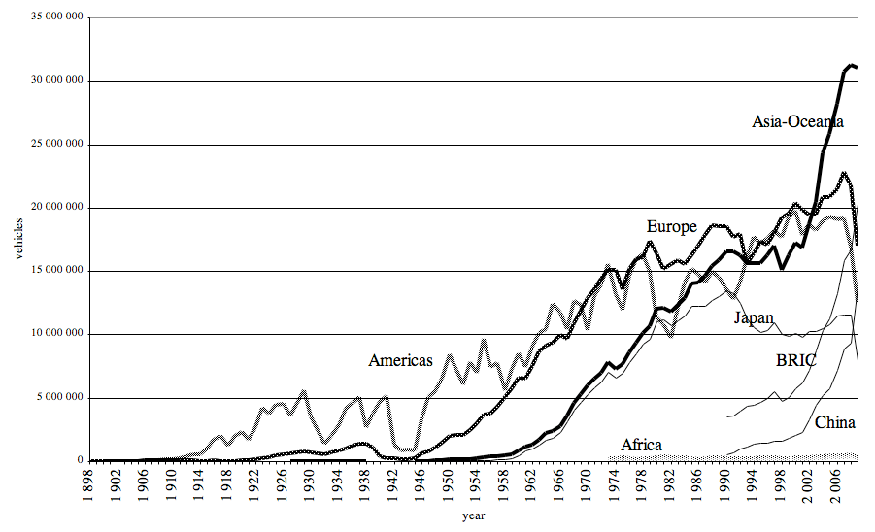
Making Sense
Complete the Making Sense section on your Student Activity Sheet.
Notes:
5. (5 min) Once students have created their graph, have them look for patterns and/or trends in their graph and compare their graph to the “World Car Production 1898-2007” graph (Fig. 7.2). Students should record their observations on their Student Activity Sheet.
Suggested Prompts:
What pattern or trend do you observe in the graph?
What do you notice about the trend as time passes?
Listen for student responses, such as
The slope of the line is steeper as time goes on.
The number of cars produced in the world is increasing.
The number of cars has increased faster in the last 20 years than the previous 80 years before then.

Slide 7
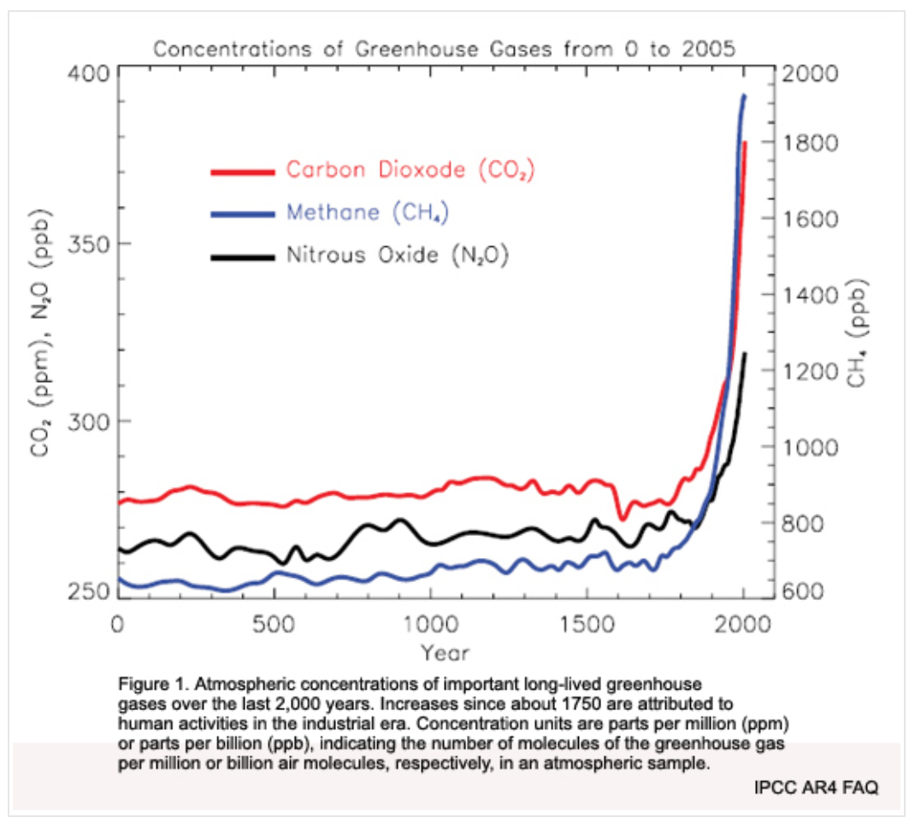
Connections
Complete the Connections section on your Student Activity Sheet.
Notes:
6. (5 min) Students then compare the graphs of car production in the world with the “Greenhouse Gas Levels in the Atmosphere” graph (Fig. 7.3). Students record their responses on their Student Activity Sheet.
Suggested Prompts:
Do you see any patterns in each of the graphs or not?
How do the two graphs compare?
How do the trends of each graph compare to each other?
Listen for student responses such as:
The two graphs each show an increasing trend.
Both graphs increase around the same time and in a similar pattern (early 1900s to recent times)
7. (5 min) After students have shared, connecting the two graphs, “What have we figured out so far?”
Suggested Prompts:
At this point, what new information and knowledge have we gained about the number of cars and the amount of CO₂ in the atmosphere?
Where do you think all these cars are in the world?
How do the number of cars connect to the CO₂ level in the atmosphere?
Listen for student responses such as:
We know that cars and CO₂ have both increased a lot, especially in the last 100 years.
Is the number of cars in other countries similar to the U.S.?
Record and post what we figured and what we are wondering: Examples:
The number of cars is increasing.
The CO₂ in the atmosphere is increasing.
The rate of car production in the world follows a similar trend to the rate of CO₂ concentration in the atmosphere.

Slide 8
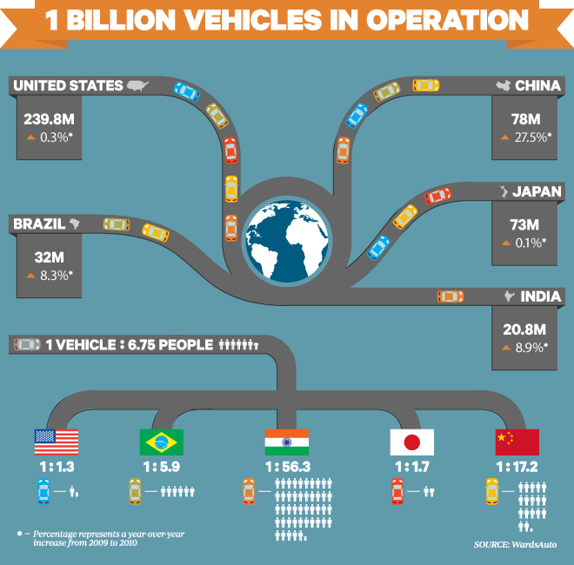
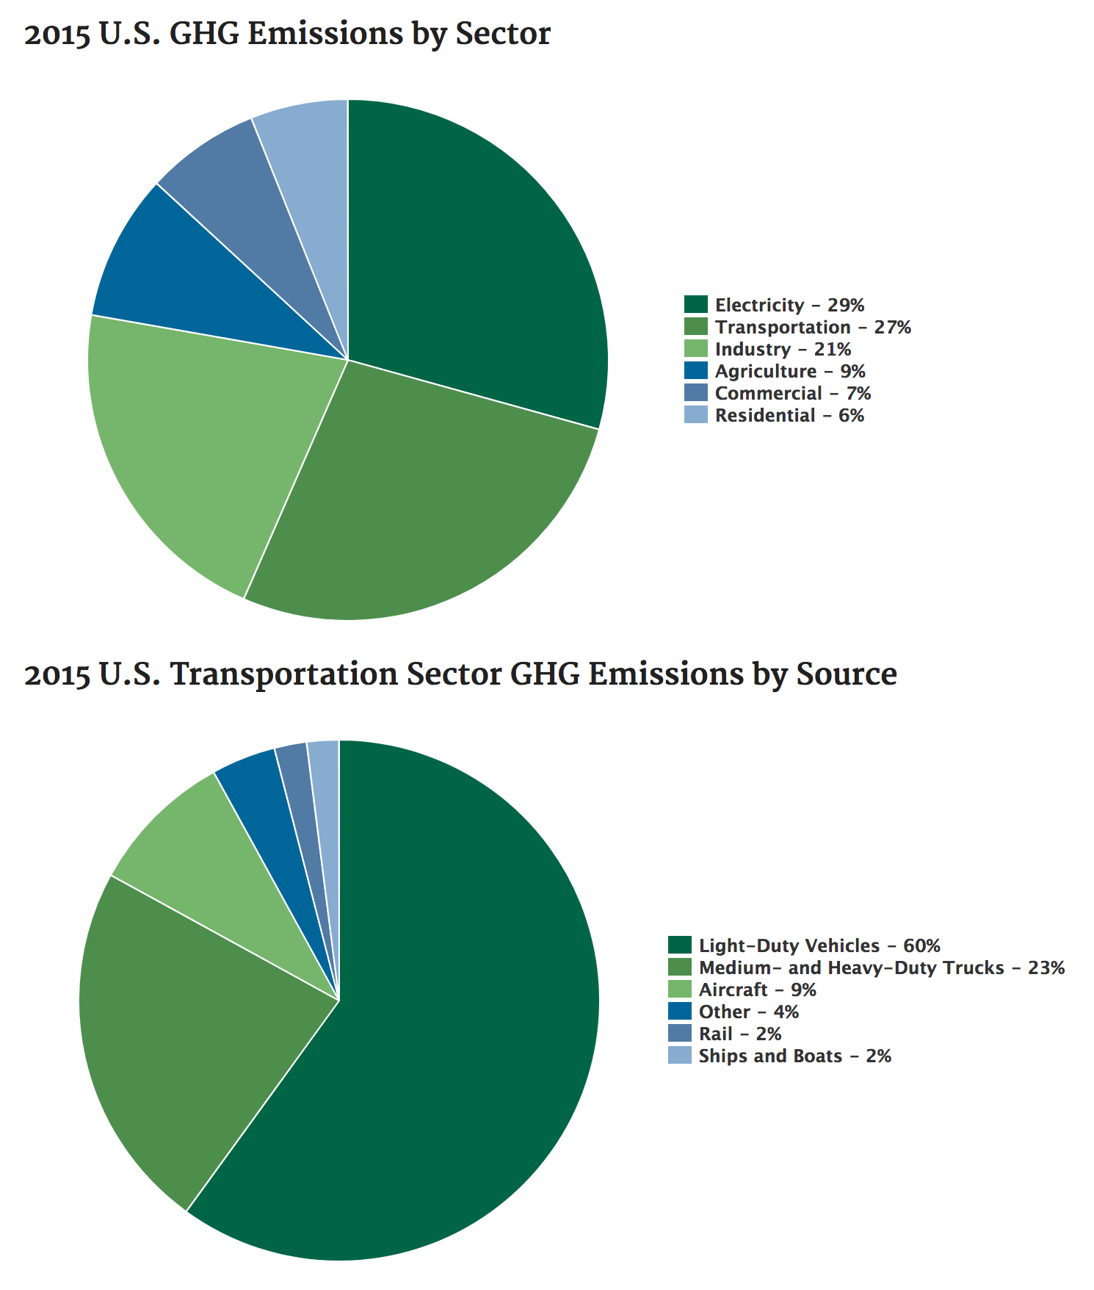
More Connections
Complete the Connections section on your Student Activity Sheet.
Notes:
8. (10 min) Ask students to analyze the “1 Billion Cars in Operation” (Fig. 7.4), “Transportation GHG Emissions in the U.S.” (Fig. 7.5) and “CO₂ Emissions from Burning Fossil Fuels” (Fig. 7.6).
Ask students what patterns they observe in the data. Students record observations on their Student Activity Sheet.
Suggested Prompts:
After comparing Figures 7.4, 7.5, 7.6, what patterns, if any, do you observe in the data?
Do you see a connection between the location of cars in the world and the highest CO₂ emissions in the world? Explain.
What do you note about transportation in the U.S. and GHG emissions?
Listen for student responses such as:
We see that the location of the cars in the world match the locations of the greatest CO₂ emissions in the world.
Almost all of the countries with the greatest number of cars has the highest emissions of CO₂.
In the U.S., transportation is one of the top GHG emitters, which comes mainly from cars and trucks.

Slide 9
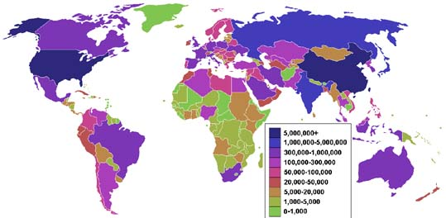
More Connections
Complete the Connections section on your Student Activity Sheet.
Notes:
8. (10 min) Ask students to analyze the “1 Billion Cars in Operation” (Fig. 7.4), “Transportation GHG Emissions in the U.S.” (Fig. 7.5) and “CO₂ Emissions from Burning Fossil Fuels” (Fig. 7.6).
Ask students what patterns they observe in the data. Students record observations on their Student Activity Sheet.
Suggested Prompts:
After comparing Figures 7.4, 7.5, 7.6, what patterns, if any, do you observe in the data?
Do you see a connection between the location of cars in the world and the highest CO₂ emissions in the world? Explain.
What do you note about transportation in the U.S. and GHG emissions?
Listen for student responses such as:
We see that the location of the cars in the world match the locations of the greatest CO₂ emissions in the world.
Almost all of the countries with the greatest number of cars has the highest emissions of CO₂.
In the U.S., transportation is one of the top GHG emitters, which comes mainly from cars and trucks.

Slide 10
What did we figure out? What questions do you have now?
Share thoughts as a class.
Notes:
9. (5 min) Before dismissing students, ask them to brainstorm what our next steps should be in our investigations.⁶
Suggested Prompts:
What should we make sure to do in our next science class?
What do we need to investigate next time we meet?
How can we connect our new knowledge to answering our big question?
Listen for student responses such as:
We now want to know if we can demonstrate that more CO₂ in the air raises its temperature.
Is there a way to show that more CO₂ makes the atmosphere temperature higher?

Slide 11
Where should we go next?
What questions and ideas do we have for how we might investigate these questions in future lessons?
Write them down on your Student Activity Sheet.
Notes:
9. (5 min) Before dismissing students, ask them to brainstorm what our next steps should be in our investigations.⁶
Suggested Prompts:
What should we make sure to do in our next science class?
What do we need to investigate next time we meet?
How can we connect our new knowledge to answering our big question?
Listen for student responses such as:
We now want to know if we can demonstrate that more CO₂ in the air raises its temperature.
Is there a way to show that more CO₂ makes the atmosphere temperature higher?

