Slide 1
Developing Your Story
Pre-Production Exercises

Slide 2
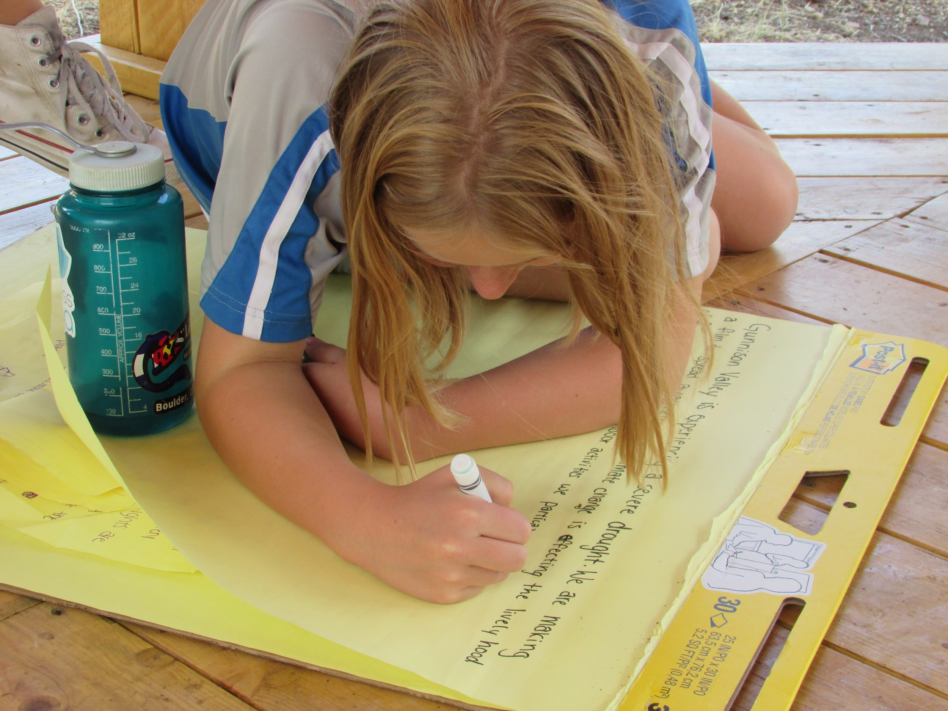
Pre-production is when you do all the planning for your film.
Research your film’s topic
Create a mission statement
Develop a storyboard

Slide 3
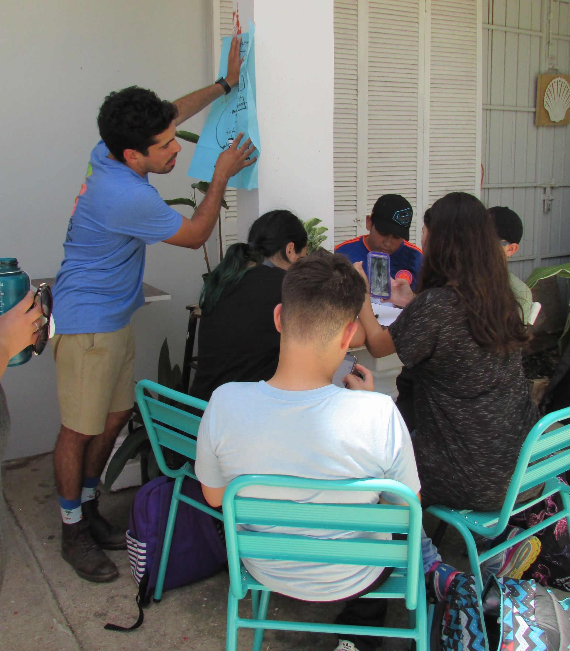
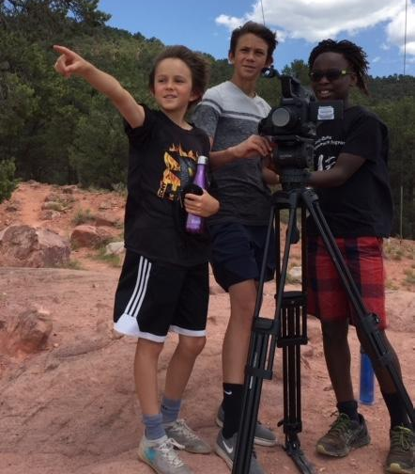
Taking time to plan is important!
Planning now saves you time when filming and editing

Slide 4
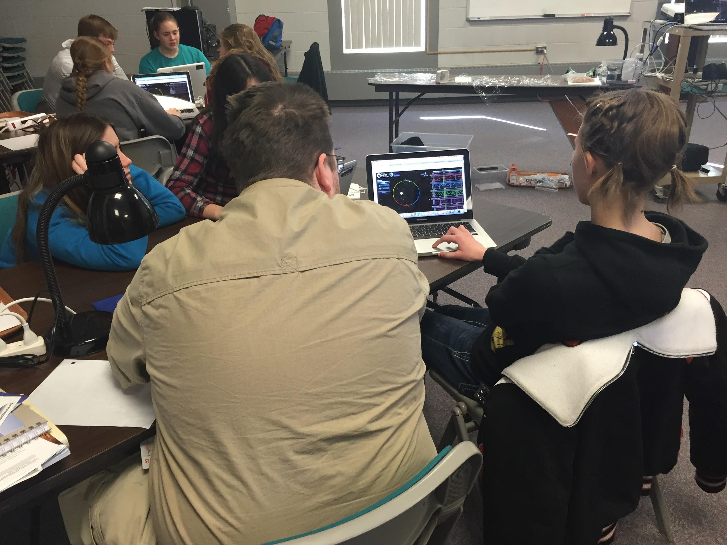
To create an impactful film, doing research on your topic is important.
Use trusted sources
Talk to local experts
Watch films that inspire you

Slide 5
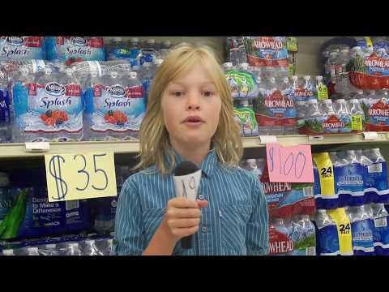
Example
Style: news show
Location: school & nearby locations
Notes:
Filmmakers shouldn’t recreate the wheel if they don’t have to. If the mission statement of your students’ film is something that other filmmakers have succeeded at, there might be lots to learn from their techniques. As such, it is valuable to have students watch other films and take notes on the methods that others used to hook, provoke, suspend in disbelief, or inform their audience. The videos shown here are meant to provide examples on different styles of films that work well to share science, as well as accessible filming locations for students.

Slide 6
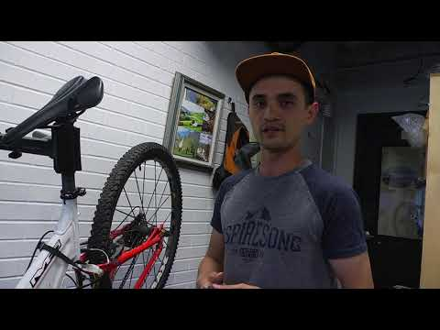
Example
Style: interview
Location: out in community

Slide 7
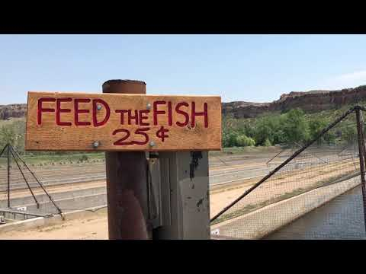
Example
Style: personal story
Location: local park and science institutions

Slide 8
Film planning begins with writing a mission statement, which defines your goal and audience.
I want to talk about…
Wildfires affecting my community
Saving the pika
Resilience after a disaster
For…
Students my age
My parents
My town

Slide 9
Over the next two weeks in Ms. K’s class, our team plans to produce a four minute mystery movie, using footage from our trip to the Aquarium, that shares the value of ocean ecosystems with 3rd-5th graders.

Slide 10
Exercise
Create Your Mission Statement
In your production teams:
Answer the questions on the handout
Write your mission statement

Slide 11
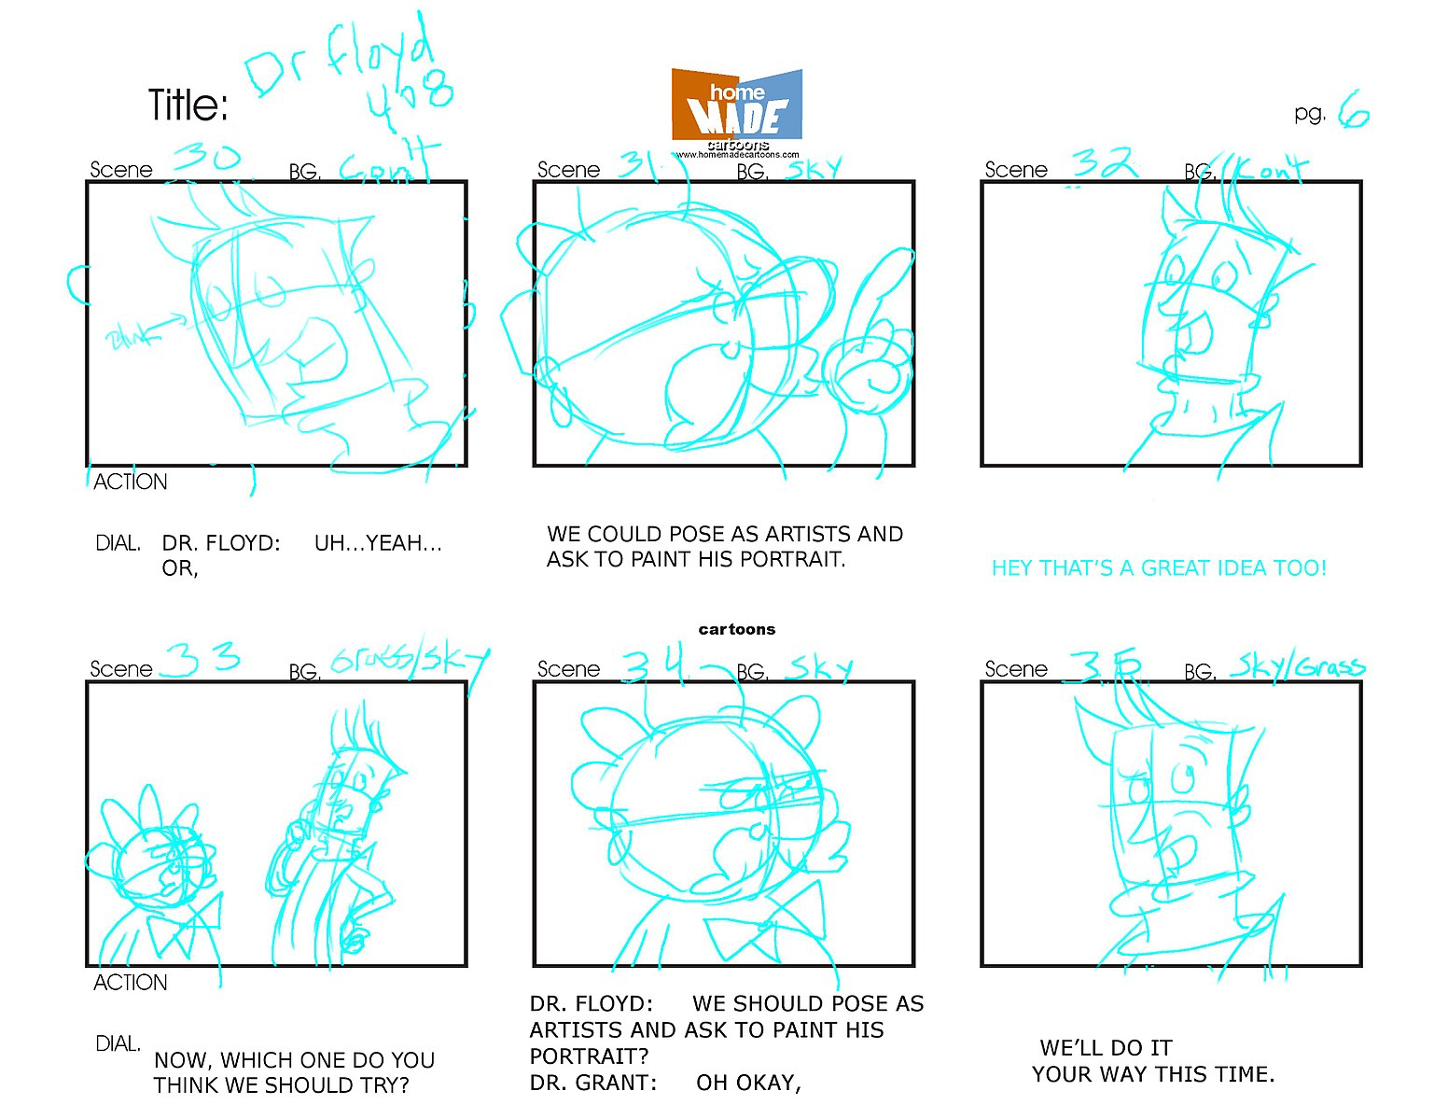
A storyboard is an important planning tool to organize your film into different scenes.
Storyboards are a sequence of drawings and text that represent each scene.
Each cell represents one shot in your film.
Drawing of characters / action
Short text description
From Tom Ray: https://www.flickr.com/photos/tmray02/1440415101/

Slide 12
Exercise
Develop Your Storyboard
In your production teams:
Use the storyboard handouts to outline your film

Slide 13
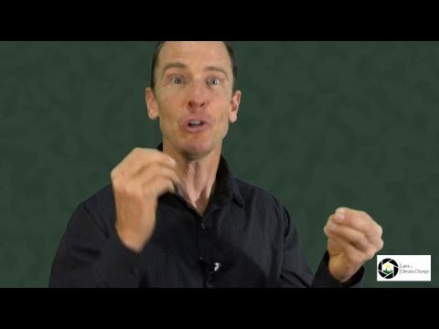
Video
Developing Stories
Notes:
This video quickly runs through basic methods in developing a story for your film.

