Slide 1
HS Climate Resiliency Unit
Lesson 3

Slide 2
Do now
What did we decide we wanted to investigate last time?
Notes:
1. (5 min) Begin with a Do Now to orient the students to the storyline and remind them of what they decided they wanted to investigate.
Suggested Prompts:
Yesterday we decided that we would plan an investigation to figure out why cities are getting hotter faster than states overall.
What are some basic differences between the regions we call cities, versus the regions we call states. Try to get at least 5 different characteristics listed in this time.

Slide 3
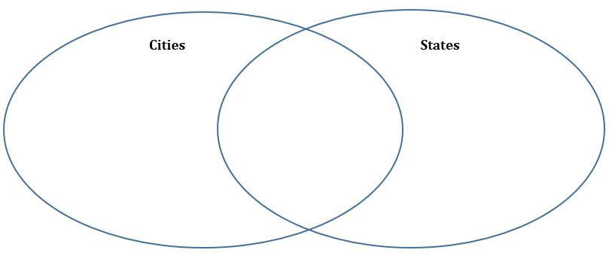
How do the landscapes of cities and states compare?
Notes:
Ask students to share their ideas and create a class list of things we know about landscapes categorized as cities versus landscapes categorized as states.
Listen for and capture student responses, such as:
Cities are smaller in area, state are larger.
People are more concentrated in cities, less dense in states.
Cities and states both have buildings; cities have more dense buildings.
Cities and states both have green spaces/trees, states have a greater percentage of trees than buildings
Cities have factories and/or cars.
States have farms.

Slide 4
Ideas
What resources could we use to better explore the differences in cities and states?
Notes:
2. (10 min) Share with students that these are just our assumptions about cities and states without taking an in depth look. What resources could allow us to enrich our list of similarities and differences between cities and states? Students should arrive at a “map” or satellite image of these two regions and be able to deduce how we can access this resource in the classroom^{A}. Once students have suggested looking at satellite imagery (such as that from Google Earth,) instruct them to work with a partner to use the resources to observe satellite images of Colorado (cities as well as rural areas and the state overall) and make note of their observations^{B}.
Suggested Prompts:
What resources could allow us to better explore differences in cities and states?
What would allow us to visually compare the land of a city such as Denver and a state such as Colorado side by side?
How can we access satellite imagery from our classroom?
What similarities and differences did you notice between city land features and state land features?
What did you figure out related to the question prompts?
List what features/objects you find on this landscape
Describe what makes up the majority of the land use.
Describe what colors are dominant on this landscape.
What patterns do you notice?
What usual things did you notice?
What else was notable in your observations?
Listen for student responses and capture the new ideas (adding to original list) for everyone to see:
There are green spaces in cities, some trees and parks but not dominant.
There are small bodies of water in the cities.
There are many cars in the cities.
The western half of the state of Colorado is greener than the eastern half.
State open space is brown and green.
Cities are mostly grey and paved.
Denver appears to be growing, a lot of construction.

Slide 5
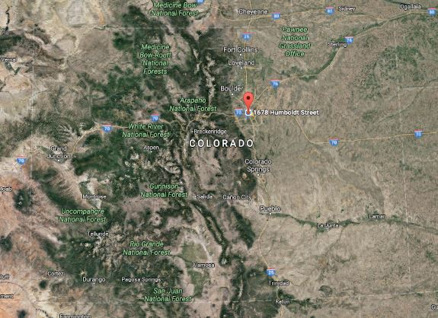

Slide 6
Driving Questions Board
((Refer to/show students their own Driving Questions Board with questions collected around topics))
Notes:
3. (5 min) Ask students what questions we have about what we are observing in cities and the state overall that we need to add to the Driving Questions Board.
Suggested Prompts:
What questions should we add to our Driving Questions Board? Which ones should we prioritize now?
Listen for student questions:
How do plants affect temperature, what about photosynthesis?
How to the mountains affect temperature?
How does having an open space affect temperature?
How does the kind of plant affect temperature (large trees vs brush)?
How do other surfaces affect temperature?
How does a city growing affect temperature?

Slide 7
Brainstorm - How can we get the information we need?
Notes:
4. (15 mins) Instruct students to circle which materials listed on their charts are accessible here on campus. Then, in pairs, write a scientific procedure for how we could investigate those materials in relation to temperature (on their Student Activity Sheet)^{C}
Suggested Prompts:
Which of these materials would we able to investigate here at school
How would we conduct this investigation?
5. (10 min) Ask students to share their procedure ideas and use students’ responses to push them towards agreeing to the investigation you have chosen to use today (either the outdoor or the indoor investigation). Write the procedure down on a large paper as students agree/edit each of the steps. Be sure to identity potential sources of error, what constants are involved in the procedure.
Suggested Prompts:
Outdoor:
What tool would we use to measure the temperature of different surfaces around campus?
What types of surfaces are most important to measure?
How can we avoid error in our investigation as student scientists?
Indoor:
How can we simulate solar heating in the classroom?
How can we simulate different land surfaces in the classroom?
How can we avoid error in our investigation as student scientists?

Slide 8
Investigation
Notes:
6. (30 mins) Have students complete the investigation about surface heating using one of the two investigations below^{D}. There are two options to choose from, based on class constraints.
Option 1: (need appropriate time of year to go outside AND infrared thermometer) Outdoor Albedo modified from NGSS. Students will use an infrared thermometer to find the temperature of different types of ground coverings. Students will test black asphalt, white concrete, grass, and one other surface of their choice. Surfaces should not be in shadow.
Instruct students to first collect data working in pairs or small lab groups based on how many thermometers are available
Students return to the classroom to compile data from their trials. Students will then calculate the average temperature of each type of ground covering. Next, they will work with their lab partner to analyze their data, and write out their analysis and conclusion on their lab report.
With 5 minutes left, have students switch out one partner with a group near them so they have a new partner. New partners will then take a few moments to share their findings, and their conclusion. Afterwards, students can move back into their original partner pairings, and make any modifications to their conclusions that they feel is necessary.
Option 2: (during winter months, if you cannot go outside, or if you only have regular thermometers) Indoor Albedo Lab. Use this investigation adapted from CLEAN Understanding Albedo.

Slide 9
Albedo Reading Guide
Complete the Albedo Reading and questions
Notes:
7. (10 mins) Have students complete the Albedo Reading Guide and questions on their own or with a partner to reinforce the idea of albedo.

Slide 10
Building Understandings
Notes:
8. (5 mins) Engage students in a Buildings Understandings Discussion using the “Day 2 Making Sense Questions” from their Student Activity Sheet. At this point, name the Urban Heat Island effect. Students should scribe final thoughts for the day on their Student Activity Sheets.
Suggested Prompts:
Why are average city temperatures hotter than average state temperatures? Let’s name this Urban Heat Island Effect.
Why are city temperatures increasing at a faster rate than state temperatures?
Listen for student responses:
Cities have more surfaces with lower albedo than states, such as pavement.
Cities have fewer trees.
Cities are growing, so that is creating more, low albedo (dark) surfaces causing more absorption of heat and increasing temperatures.

Slide 11
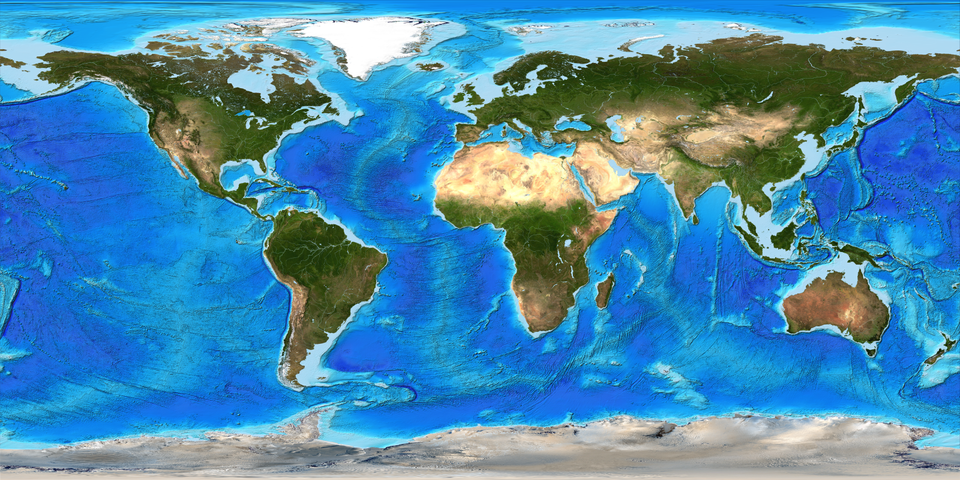
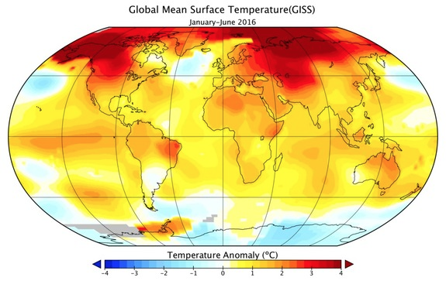
Thought Experiment
Notes:
9. (10 min) As a thought experiment or for homework, have students complete the last section of the Student Activity Sheet. At the end of this lesson or the beginning of the next lesson, have a Consensus Building Discussion about the contradiction between what we would expect to see given the investigation results (greater warming in places with low albedo) and what we saw in the map data in lesson 2 (greater warming in places with high albedo like snow and ice in the arctic).
Suggested Prompts:
Where do you expect low albedo areas to be on the world map? What about high albedo areas?
What effect does albedo have on temperature? Based on albedo alone, where do we expect the largest temperature increases? What about the smallest temperature increases?
When you compared the albedo world map with the temperature anomaly world map, what did you notice?
Listen for student responses:
We would expect low albedo areas to be developed areas where there are many people like areas in the US with big cities.
We would expect high albedo areas to have a lot of reflective land cover like ice and snow. For example, the Arctic.
In urban heat islands, the low albedo areas have high temperatures and the high albedo areas have lower temperatures. However, in the global trend data, the temperatures are increasing the most in the Arctic. What’s going on? Why is this happening? What’s missing from our explanation?
Why do small (microscale) systems follow the trend we expect but large (macrsocale) systems do not? What does this mean about what's happening? Answer: it tells us that there are very large scale effects that do not matter on the small time/space scales, but do matter on the large time/space scales.)

Slide 12
What questions do you have now?
Write them down.
Notes:
Give students a moment to stop and jot some ideas for questions they now have and ways we might investigate these questions further in the next and future lessons on their Student Activity Sheet.

Slide 13
Where should we go next?
What questions and ideas do we have for how we might investigate these questions in future lessons?
Notes:
Suggested Prompts:
What did we figure out today?
What new questions do you have?
What should we investigate next?
Listen for student responses^{E}:
We figured out that albedo could be part of an explanation for why cities are getting hotter than rural areas.
We are wondering what explains the increase in temperature in places like the Arctic that reflect back most light as they shouldn’t be warming as fast as the global trends data suggests they are.
We have heard of Greenhouse Gases and have decided we need to make a model and figure out where human activity fits in and what this has to do with Greenhouse Gases.

