Slide 1
Why are growing cities hotter?
Lesson 3

Slide 2
DO NOW
During our last class, we looked at different types of information about the cities that are getting hotter.
Answer these questions on your activity sheet:
What things did we decide are NOT causing cities to get hotter?
What things did we decide ARE causing cities to get hotter?
What did we decide we still need to figure out?
Notes:
1. (15 min) Begin with a Consensus Building Discussion ¹ to help reorient students in the storyline. Use the following prompts to help students articulate what they figured out in the last lesson.
Suggested Prompts:
During our last class, we looked at different types of information about the cities that are getting hotter. What things did we decide are NOT causing temperatures to increase? What things did we decide ARE causing temperatures to increase?
What did we decide that we still need to figure out?
Listen for student responses ² that refer to what we figured out last time, such as:
We decided that the amount of sun is not causing temperatures to increase.
Ask: What evidence showed us this?
We decided that the amount of precipitation is not causing temperatures to increase.
Ask: What evidence showed us this?
We decided that increased population is causing the temperature to increase.
Ask: What evidence showed us this?
We decided that when there are more people in an area, the people will replace areas that used to be full of plants with buildings, parking lots, and other human-made structures.
Ask: What evidence showed us this?
We decided we needed to investigate some cities that have grown a lot in the past few years to see if we can find a pattern here that helps us answer this question.
Ask: What kind of a pattern should we look for? What will this tell us?
What if we do not see this pattern? What else could we look for?

Slide 3
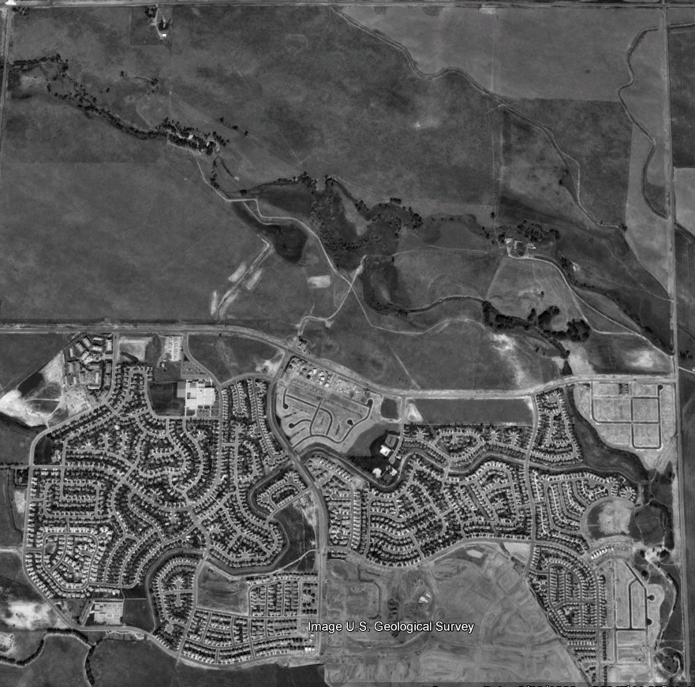
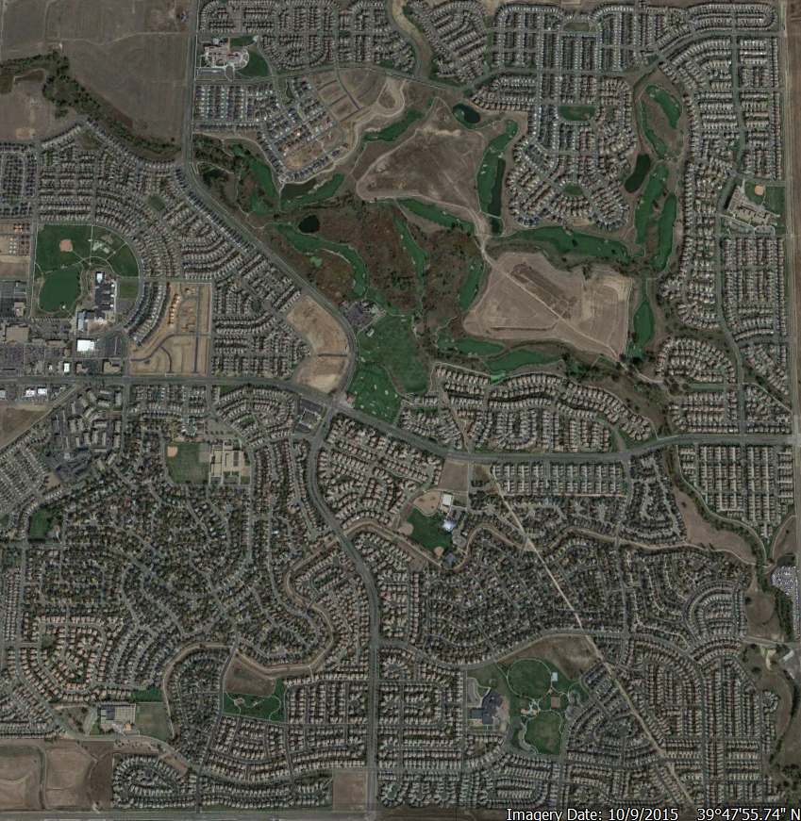
Green Valley Ranch, CO
1999 2015
Notes:
2. (35 min) Picture comparisons: Show students pairs of pictures of areas that have increased in population over the last 30 or so years.
Ask students:
What looks different between the two pictures?
What are your ideas about what caused these changes?
Why did these changes happen?
How might those things affect temperatures? Why do you think that?
Listen for:
Earlier picture: more grass/vegetation
Later picture: more buildings/roads/parking lots
More people would need more buildings to live, work, and go to school in
More people would need more roads for more cars
Buildings might produce heat that warms up the air, or they might absorb more heat from the sun. We’re not really sure, we have different ideas about it.
Show students infrared and true-color images of an area.
https://science.nasa.gov/science-news/science-at-nasa/1998/essd20nov98_1/
Explain that infrared pictures show the temperatures of different things, represented with colors. (Many students will be able to make a connection with TV shows that use infrared cameras to find people inside of buildings or for night vision goggles.)
Ask students:
Which areas are the warmest? What types of surfaces do these areas have?
Which areas are the coolest? What types of surfaces do these areas have?
What might cause the different surfaces to be warmer or cooler?
Do these give us new ideas about what growing cities might mean for temperatures?
Listen for:
The warmest areas are where there are buildings and roads.
This might be because they are made by people, or because of the materials they are made from, or because this is where people and cars are going to be the most.
The coolest areas are where there are trees or other plants.
This might be because they are made of natural materials, or because these areas don’t have as many people or cars, or because of something that the plants do to make the air cooler.
Sometimes darker surfaces are warmer and lighter surfaces are cooler.
This might be because dark surfaces absorb more heat from the sun than lighter surfaces.
We think that the information suggests that changing the surface will matter for temperatures, and so we need to test it somehow.
We think that in general, we see higher temperatures in the city where the surfaces are concrete.
Ask students to consider some initial ideas for planning an investigation to measure the temperature of different surfaces.
Ask students:
How can we tell which areas are warmer?
How can we tell which areas are cooler?
How can we measure the temperature of different surfaces?

Slide 4
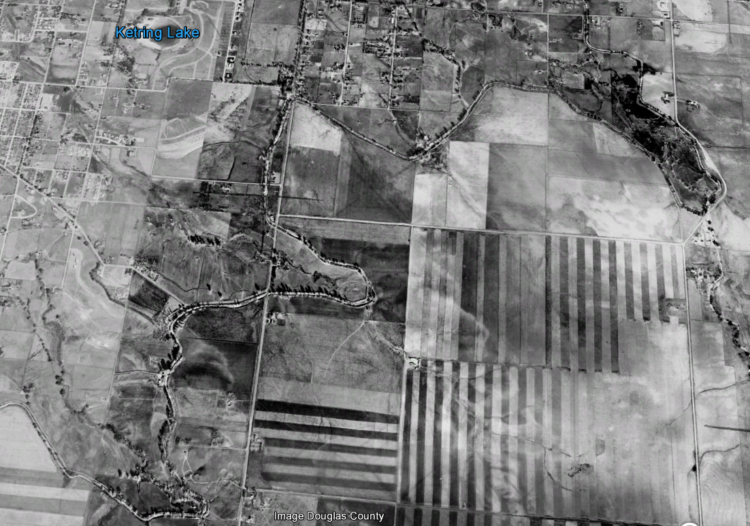
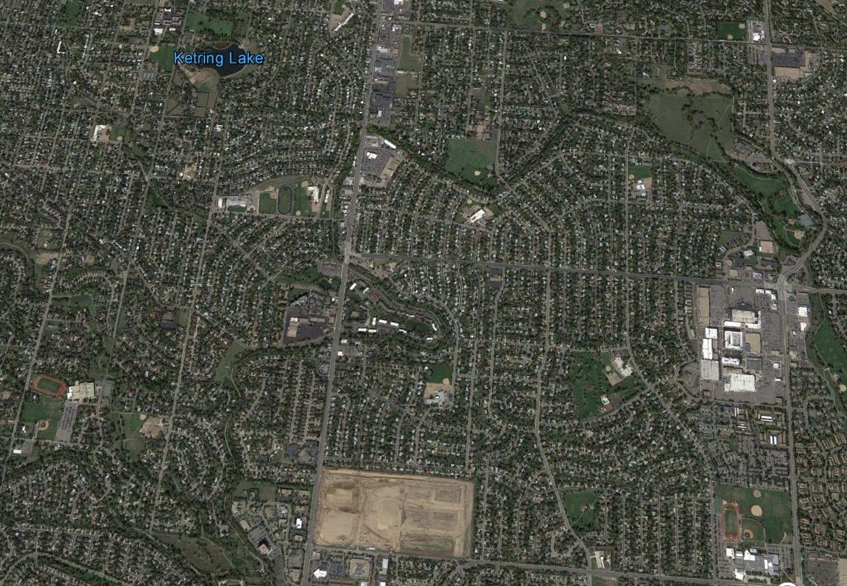
Littleton/Southglenn, CO
1999 2015
Notes:
2. (35 min) Picture comparisons: Show students pairs of pictures of areas that have increased in population over the last 30 or so years.
Ask students:
What looks different between the two pictures?
What are your ideas about what caused these changes?
Why did these changes happen?
How might those things affect temperatures? Why do you think that?
Listen for:
Earlier picture: more grass/vegetation
Later picture: more buildings/roads/parking lots
More people would need more buildings to live, work, and go to school in
More people would need more roads for more cars
Buildings might produce heat that warms up the air, or they might absorb more heat from the sun. We’re not really sure, we have different ideas about it.
Show students infrared and true-color images of an area.
https://science.nasa.gov/science-news/science-at-nasa/1998/essd20nov98_1/
Explain that infrared pictures show the temperatures of different things, represented with colors. (Many students will be able to make a connection with TV shows that use infrared cameras to find people inside of buildings or for night vision goggles.)
Ask students:
Which areas are the warmest? What types of surfaces do these areas have?
Which areas are the coolest? What types of surfaces do these areas have?
What might cause the different surfaces to be warmer or cooler?
Do these give us new ideas about what growing cities might mean for temperatures?
Listen for:
The warmest areas are where there are buildings and roads.
This might be because they are made by people, or because of the materials they are made from, or because this is where people and cars are going to be the most.
The coolest areas are where there are trees or other plants.
This might be because they are made of natural materials, or because these areas don’t have as many people or cars, or because of something that the plants do to make the air cooler.
Sometimes darker surfaces are warmer and lighter surfaces are cooler.
This might be because dark surfaces absorb more heat from the sun than lighter surfaces.
We think that the information suggests that changing the surface will matter for temperatures, and so we need to test it somehow.
We think that in general, we see higher temperatures in the city where the surfaces are concrete.
Ask students to consider some initial ideas for planning an investigation to measure the temperature of different surfaces.
Ask students:
How can we tell which areas are warmer?
How can we tell which areas are cooler?
How can we measure the temperature of different surfaces?

Slide 5
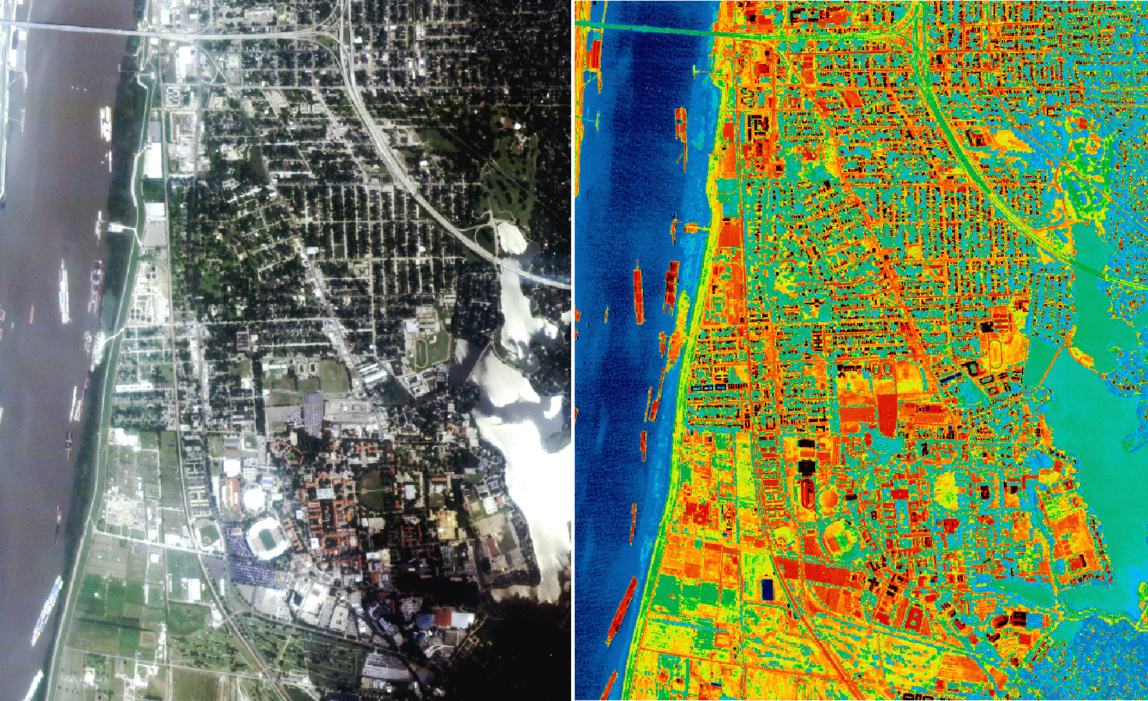
Baton Rouge, LA: True Color and Infrared Images
Which areas are the warmest?
What types of surfaces do those areas have?
Which areas are the coolest?
What types of surfaces do those areas have?
Notes:
2. (35 min) Picture comparisons: Show students pairs of pictures of areas that have increased in population over the last 30 or so years.
Ask students:
What looks different between the two pictures?
What are your ideas about what caused these changes?
Why did these changes happen?
How might those things affect temperatures? Why do you think that?
Listen for:
Earlier picture: more grass/vegetation
Later picture: more buildings/roads/parking lots
More people would need more buildings to live, work, and go to school in
More people would need more roads for more cars
Buildings might produce heat that warms up the air, or they might absorb more heat from the sun. We’re not really sure, we have different ideas about it.
Show students infrared and true-color images of an area.
https://science.nasa.gov/science-news/science-at-nasa/1998/essd20nov98_1/
Explain that infrared pictures show the temperatures of different things, represented with colors. (Many students will be able to make a connection with TV shows that use infrared cameras to find people inside of buildings or for night vision goggles.)
Ask students:
Which areas are the warmest? What types of surfaces do these areas have?
Which areas are the coolest? What types of surfaces do these areas have?
What might cause the different surfaces to be warmer or cooler?
Do these give us new ideas about what growing cities might mean for temperatures?
Listen for:
The warmest areas are where there are buildings and roads.
This might be because they are made by people, or because of the materials they are made from, or because this is where people and cars are going to be the most.
The coolest areas are where there are trees or other plants.
This might be because they are made of natural materials, or because these areas don’t have as many people or cars, or because of something that the plants do to make the air cooler.
Sometimes darker surfaces are warmer and lighter surfaces are cooler.
This might be because dark surfaces absorb more heat from the sun than lighter surfaces.
We think that the information suggests that changing the surface will matter for temperatures, and so we need to test it somehow.
We think that in general, we see higher temperatures in the city where the surfaces are concrete.
Ask students to consider some initial ideas for planning an investigation to measure the temperature of different surfaces.
Ask students:
How can we tell which areas are warmer?
How can we tell which areas are cooler?
How can we measure the temperature of different surfaces?

Slide 6
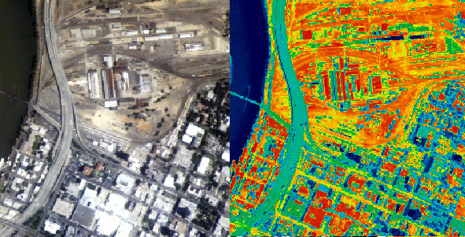
Sacramento, CA: True Color and Infrared Images
Which areas are the warmest?
What types of surfaces do those areas have?
Which areas are the coolest?
What types of surfaces do those areas have?
Notes:
2. (35 min) Picture comparisons: Show students pairs of pictures of areas that have increased in population over the last 30 or so years.
Ask students:
What looks different between the two pictures?
What are your ideas about what caused these changes?
Why did these changes happen?
How might those things affect temperatures? Why do you think that?
Listen for:
Earlier picture: more grass/vegetation
Later picture: more buildings/roads/parking lots
More people would need more buildings to live, work, and go to school in
More people would need more roads for more cars
Buildings might produce heat that warms up the air, or they might absorb more heat from the sun. We’re not really sure, we have different ideas about it.
Show students infrared and true-color images of an area.
https://science.nasa.gov/science-news/science-at-nasa/1998/essd20nov98_1/
Explain that infrared pictures show the temperatures of different things, represented with colors. (Many students will be able to make a connection with TV shows that use infrared cameras to find people inside of buildings or for night vision goggles.)
Ask students:
Which areas are the warmest? What types of surfaces do these areas have?
Which areas are the coolest? What types of surfaces do these areas have?
What might cause the different surfaces to be warmer or cooler?
Do these give us new ideas about what growing cities might mean for temperatures?
Listen for:
The warmest areas are where there are buildings and roads.
This might be because they are made by people, or because of the materials they are made from, or because this is where people and cars are going to be the most.
The coolest areas are where there are trees or other plants.
This might be because they are made of natural materials, or because these areas don’t have as many people or cars, or because of something that the plants do to make the air cooler.
Sometimes darker surfaces are warmer and lighter surfaces are cooler.
This might be because dark surfaces absorb more heat from the sun than lighter surfaces.
We think that the information suggests that changing the surface will matter for temperatures, and so we need to test it somehow.
We think that in general, we see higher temperatures in the city where the surfaces are concrete.
Ask students to consider some initial ideas for planning an investigation to measure the temperature of different surfaces.
Ask students:
How can we tell which areas are warmer?
How can we tell which areas are cooler?
How can we measure the temperature of different surfaces?

Slide 7
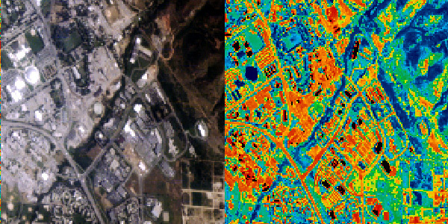
Salt Lake City, UT: True Color and Infrared Images
Which areas are the warmest?
What types of surfaces do those areas have?
Which areas are the coolest?
What types of surfaces do those areas have?
Notes:
2. (35 min) Picture comparisons: Show students pairs of pictures of areas that have increased in population over the last 30 or so years.
Ask students:
What looks different between the two pictures?
What are your ideas about what caused these changes?
Why did these changes happen?
How might those things affect temperatures? Why do you think that?
Listen for:
Earlier picture: more grass/vegetation
Later picture: more buildings/roads/parking lots
More people would need more buildings to live, work, and go to school in
More people would need more roads for more cars
Buildings might produce heat that warms up the air, or they might absorb more heat from the sun. We’re not really sure, we have different ideas about it.
Show students infrared and true-color images of an area.
https://science.nasa.gov/science-news/science-at-nasa/1998/essd20nov98_1/
Explain that infrared pictures show the temperatures of different things, represented with colors. (Many students will be able to make a connection with TV shows that use infrared cameras to find people inside of buildings or for night vision goggles.)
Ask students:
Which areas are the warmest? What types of surfaces do these areas have?
Which areas are the coolest? What types of surfaces do these areas have?
What might cause the different surfaces to be warmer or cooler?
Do these give us new ideas about what growing cities might mean for temperatures?
Listen for:
The warmest areas are where there are buildings and roads.
This might be because they are made by people, or because of the materials they are made from, or because this is where people and cars are going to be the most.
The coolest areas are where there are trees or other plants.
This might be because they are made of natural materials, or because these areas don’t have as many people or cars, or because of something that the plants do to make the air cooler.
Sometimes darker surfaces are warmer and lighter surfaces are cooler.
This might be because dark surfaces absorb more heat from the sun than lighter surfaces.
We think that the information suggests that changing the surface will matter for temperatures, and so we need to test it somehow.
We think that in general, we see higher temperatures in the city where the surfaces are concrete.
Ask students to consider some initial ideas for planning an investigation to measure the temperature of different surfaces.
Ask students:
How can we tell which areas are warmer?
How can we tell which areas are cooler?
How can we measure the temperature of different surfaces?

Slide 8
Color & temperature investigation
How does the color of a surface affect how much it will warm up in the sun?
Notes:
3. (50 minutes) Student Activity Sheet (Color and Temperature Parts A & B): Suggest to students that we try to replicate these connections in the lab. If we can, we have clearer evidence about what causes the differences in temperatures.³
Investigation Part A, ask students:
How does the color of a surface affect how much it warms up in the sun?
Students then individually write their hypothesis on the activity sheet.
Next, share hypotheses as a class.
Part A: Plan the steps of your group’s investigation to test which color of paper gets the warmest using the following materials:
Various colors of construction paper (black, white plus green, yellow, red, orange, blue, etc.)
3 thermometers
Stopwatch or timer
Light source (indoors: desk lamp or sunny windowsill, outdoors: sunshine)
Part A: Plan the procedure:
In teams of 2-4 students, write your ideas for an investigation on temperature on chart paper before doing the investigation.
Next, have a class discussion to get feedback on which plan is likely to work best for investigating surface temperatures.
Then, revise the investigation as a class and implement the plan in teams.
Part A: Conduct the investigation and record observations:
After testing, ask:
Which color paper had the warmest temperature?
Which color paper had the coolest temperature?
Was your hypothesis supported by your observations? Why or why not?
Part B: Plan the steps of your group’s investigation to test which color of paper melts an ice cube the fastest using the following materials:
Various colors of construction paper (black, white plus green, yellow, red, orange, blue, etc.)
3 ice cubes
Stopwatch or timer
Light source (indoors: desk lamp or sunny windowsill, outdoors: sunshine)
Part B: Plan the procedure:
In teams of 2-4 students, write your ideas for an investigation on temperature on chart paper before doing the investigation.
Next, have a class discussion to get feedback on which plan is likely to work best for investigating surface temperatures.
Then, revise the investigation as a class and implement the plan in teams.
Before testing, ask:
If darker surfaces absorb more heat from the sun, what will happen to the temperature and the ice cube on the dark paper? What will happen to the temperature and the ice cube on the light paper? What will happen to the temperature and the ice cube on the green paper?
Listen for:
The ice cube will melt faster on the darker paper than on the lighter paper.
Part B: Conduct the investigation and record observations:
After testing, ask:
On which color paper did the ice cube melt the fastest?
On which color paper did ice cube melt the slowest?
What does this information tell us about why temperatures in cities are warming?
Discuss Part A & B Conclusions:
(1) Aggregate data from different student groups;
(2) discuss patterns in data
(3) draw conclusions from data
(4) revise model to reflect data
Investigation Reflection:
What types of land surfaces does the dark color represent?
What types of land surfaces does the light color represent?
What does our data tell us about the color of a surface and its temperature?
Listen for:
The dark colors represent dark surfaces, like asphalt or black roofs of buildings.
The light colors represent light surfaces, like cement or light gray roofs of buildings.
The plant colors (i.e. green or yellow) represent vegetation, like trees, grasses, flowers or crops.
The ice cubes melt more quickly on the darker papers than on the lighter papers.
The darker papers got warmer faster than the lighter papers.
In the sun, darker surfaces will get warmer than lighter surfaces.

Slide 9
What have we learned?
How do different colors of surfaces affect the temperatures of places?
What does this tell us about cities that are increasing in population and their temperatures?
Notes:
4. (15 min) Have students reflect on what we have figured out about temperatures and growing cities. Use the following prompts to guide this Consensus Building Discussion.
Suggested Prompts:
How does the presence of many plants (forest, field) affect the temperature of a place compared to a place without those plants?
How do different colors of surfaces affect the temperatures of places?
What does this tell us about cities that are increasing in population and their temperatures?
At the end of the discussion, introduce “albedo” as the scientific term to describe the phenomenon that darker colors reflect less light energy and lighter colored surfaces reflect more light energy.
Listen for student responses such as:
It seems like places with plants do not get as hot as places without plants, so people moving to a city and changing farmland, fields, and forests into streets and buildings will make the temperature go up.
More buildings or streets with dark colors will make the temperature go up even faster.

Slide 10
What’s next?
What should we investigate next?
Notes:
5. (10 min) Ask student to brainstorm what our next steps should be in our investigations.⁴
Suggested Prompts:
What do we need to investigate next time we meet for science?
Listen for student responses such as:
We should look at data from different areas, including places where population is growing versus staying the same, and see if the same increase in temperature is happening in the different areas.

