Slide 1
2B Making Sense of Magnetism!
student-led activities to investigate and understand magnetic fields
Adapted resource courtesy of
Deborah Scherrer, Stanford Solar Center

Slide 2
Materials: Each team needs the following activity items:
Activity 1: Exploring Magnetic Poles
magnaprobe
1 bar magnet
1 flat magnet
3-D circle magnet
Lodestone
pencil
Activity 2: Observing Magnetic Field Lines
4 pieces of 8.5”x11” paper
tape
2 bar magnets
compass
plastic Wrap
iron filings
small Box
pencil
Activity 3: Magnetic Sunspots
2 sunspot field papers
1 horseshoe or 2 bar magnets
compass
pencil

Slide 3
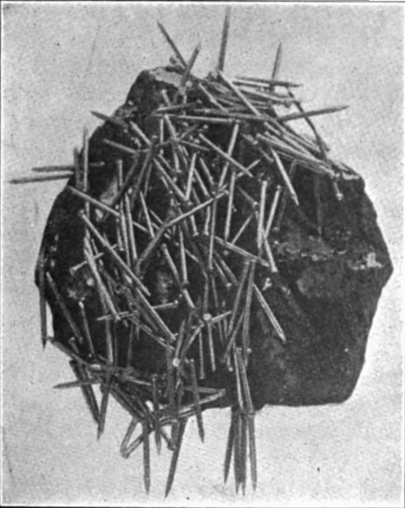
Magnets on Earth
Lodestones are naturally occurring magnetic rocks with the mineral magnetite (Fe₃O₄). Lodestones were discovered by the ancient Chinese and Greeks about 3,000 years ago.
The concept of an Earth compass was discovered by the Chinese around 2,000 years ago.
Meteorites were recognized as metal and may have been recognized as being magnetic by ancient people, too.

Slide 4
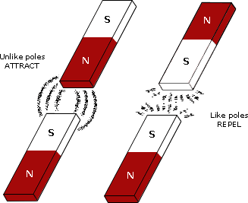
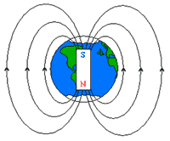
Magnets have at least 2 poles (a dipole):
Opposite poles attract:
-North & South poles attract
Like poles repel:
-North & North and South & South poles repel
Magnetic dipoles are labeled as +/-, North/South, red/blue, etc.
Earth’s north magnetic pole is negative and the south pole is positive.
(- polarity) and attracts the positive
(+ polarity) compass needle.

Slide 5
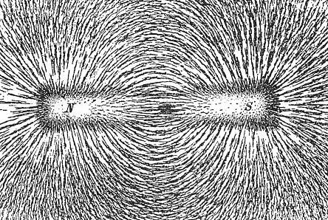
Magnetic Field Lines
Magnetic field lines represent where the magnetic fields are located.
Magnetic fields cannot be seen but their effects can be detected and measured.

Slide 6
Activity 1: Exploring Magnetic Poles
Locate and identify polarity of magnetic poles
Use the Magnaprobe to explore poles in various magnetic objects. Record your observations as a team.
Where are the poles in a bar magnet?
Where are the poles in a flat magnet?
Where are the poles in a sphere (3-D circle) magnet?
What determines where the poles are in a magnet?
What happens to the poles if you break a magnet in half?
Can a magnet have more than 2 poles? Try to find out!
How many poles does a lodestone have?
Notes:
Divide participants into teams and pass out:
Magnaprobe (pole finder)
Bar magnet
Flat ceramic magnet
Magnetic marble
Lodestone, if available
Other interesting magnets, if available

Slide 7
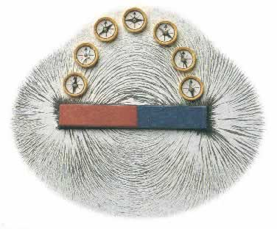
Activity 2: Observing Magnetic Field Lines
Locate magnetic field lines with a magnet & compass
Wrap one bar magnet with plastic wrap and place it in the box.
Using a compass identify which pole of the magnet is North (-) and S (+) and label an “N” and “S” at the correct end of the magnet.
Label the correct polarity, + or -, on the N and S poles of the magnet.
Evenly sprinkle iron filings around the box without moving the magnet.
Observe how the iron filings to arrange themselves around the magnet. Do not touch the filings or magnet!

Slide 8
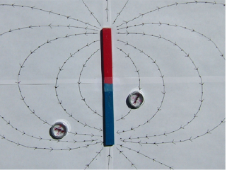
Activity 2: Observing Magnetic Field Lines Lab Sheet
Trace magnetic field lines with a magnet and compass
1. Tape two pieces of 8.5”x11” paper together length-wise, then place the paper under your magnet. Wrap the magnet in plastic wrap and tape the magnet in the middle of the paper, as in the picture to the right.
2. What happens when you put a compass next to a magnet? What happens when you take the compass further away? What happens when you put it close to a different part of the magnet?
3. To trace the magnetic field lines, do the following:
Draw a dot somewhere near the magnet and place the center of a compass over the dot.
Draw a dot at the location of the arrow head (or tail) of the compass needle.
Draw a line to connect the two dots.
Move the compass center directly over the second dot, and again draw a dot at the location of the compass needle head or tail.
Continue these steps, marking the direction of the needle with dots and connecting them until the line meets the magnet or the edge of the paper. Go back to the first dot and repeat these steps until the other end of the line also meets the magnet or the paper edge.
When finished with the first line, pick another spot near the magnet and repeat the process to trace more field lines.
activity credit: http://sunearthday.nasa.gov/2007/materials/magnetic_field_lines.pdf

Slide 9
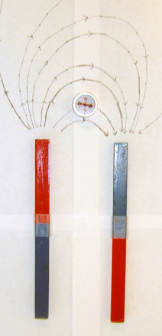
Sunspots are usually in pairs and have magnetic poles, like a magnet!
2. Observing Magnetic Field Lines
Trace magnetic field lines between opposite magnetic poles
Correctly label the N (-) and S (+) poles of two bar magnets. Wrap the magnets separately in plastic wrap.
Place the two magnets parallel to each other, with their poles in opposite directions, on top of the paper. Tape the magnets is place, as in the picture at the right.
Correctly trace the direction of ten magnetic field lines, using directional arrows, between the opposite poles of two bar magnets.

Slide 10
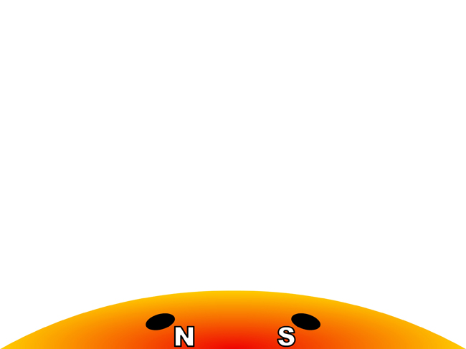
Activity 3: Magnetic Sunspots Lab Sheet
Predict the magnetic field of sunspots
Predict what the magnetic field of a sunspot pair might look like.
Draw your prediction.

Slide 11
Activity 3: Magnetic Sunspots Lab Sheet
Model the magnetic field of sunspots
Line up a horseshoe magnet or two bar magnets with the north and south pole designations on the sunspot pair image.
Use the compass, as you did in Activity 2, to draw the magnetic field lines between the sunspot pair.

Slide 12
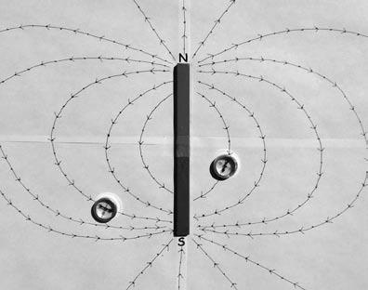
Discussion: What did your team discover
about magnetic fields?
Explain how this activity proves that magnetic fields exist even though we can’t see them.
At which pole (N or S, + or -) do the magnetic field lines start? Which pole are the magnetic field lines attracted to (N or S, + or -)? Is this direction the same for all magnetic field lines?
Describe how magnetic field lines are arranged – are they random or in a pattern? What happens to magnetic field lines directly at the poles? Explain with evidence.
Summarize the relationship between magnetic fields and sunspots. Explain how sunspots are a source of space weather, such as “solar storms”.

